Slide 1
Tick-borne Infections in Children
Jennifer Vodzak, MD
Pediatric Infectious Diseases
Director, Pediatric Quality, Safety & Best Practice
Geisinger Janet Weis Children’s Hospital
Pediatric Update
in Pennsylvania
June 23, 2021
I have no disclosures
Notes:
This presentation demonstrates the new capabilities of PowerPoint and it is best viewed in Slide Show. These slides are designed to give you great ideas for the presentations you’ll create in PowerPoint 2010!
For more sample templates, click the File tab, and then on the New tab, click Sample Templates.

Slide 2
Objectives tick-borne infections
1
2
3
describe
epidemiology of ticks and tickborne pathogens
in Pennsylvania
summarize
current diagnostic and treatment strategies for tickborne illnesses including Lyme,
anaplasmosis and babesiosis
discriminate
between medical science and internet-based distortions
to aid in optimal care of children related to tickborne infections

Slide 3

Tick-borne infections in the northeast United States
Epidemiology
Anaplasma, Babesia, Powassan
Lyme
Q&A

Slide 4
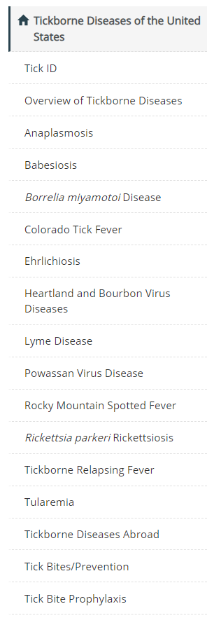
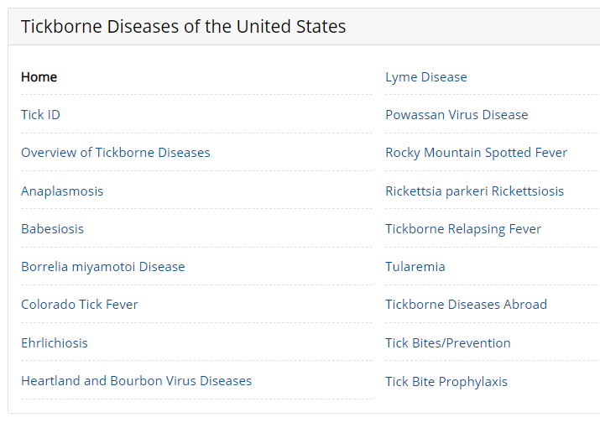
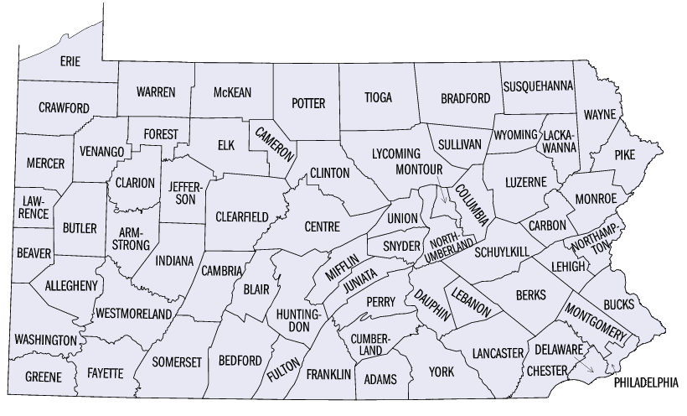
https://www.cdc.gov/ticks/tickbornediseases/index.html

Slide 5
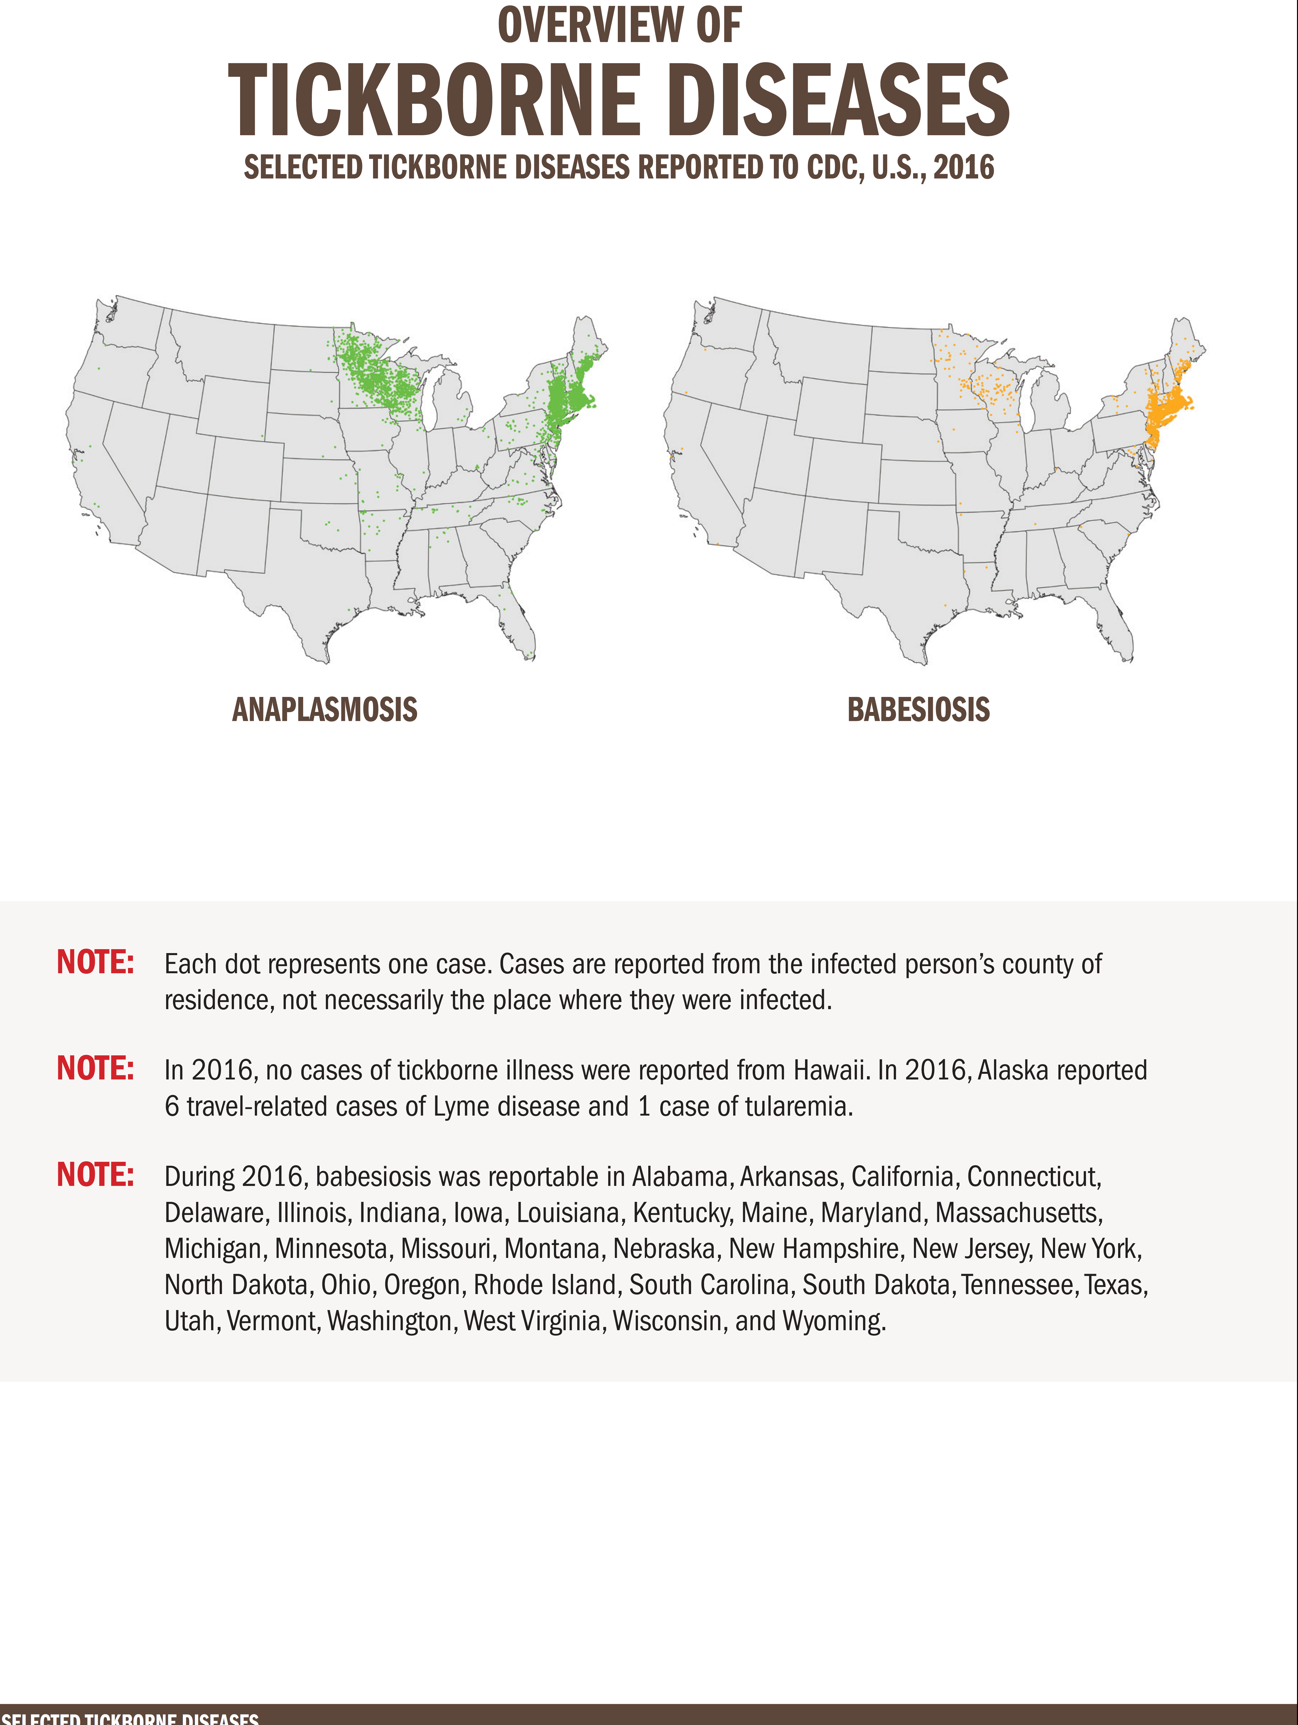
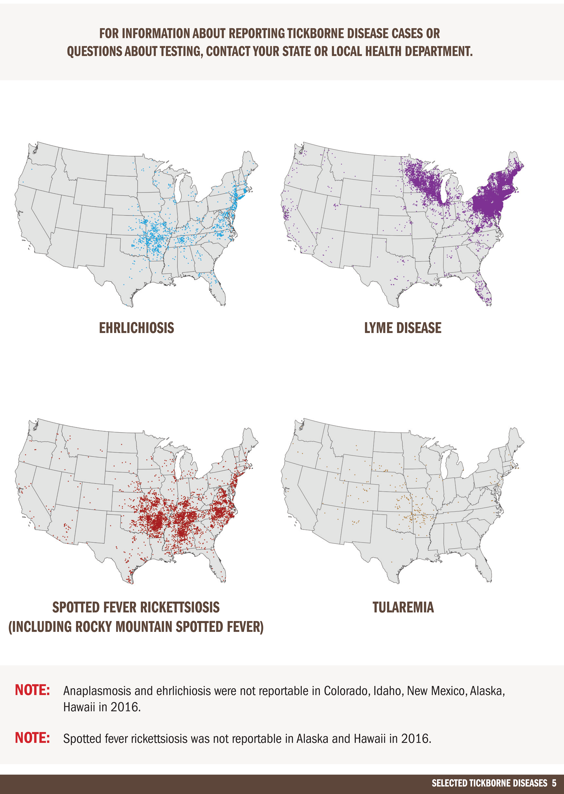
www.cdc.gov

Slide 6
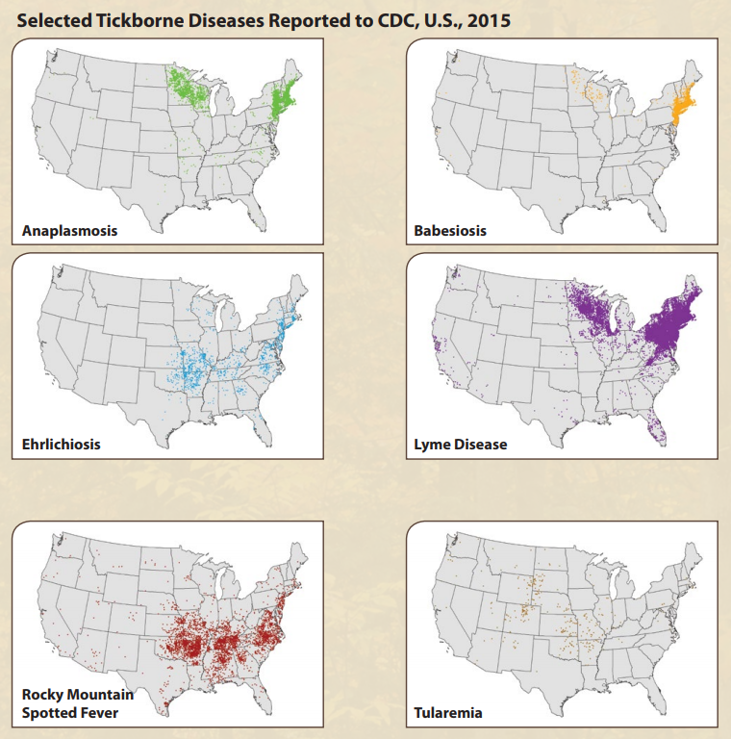
Pennsylvania
Borrelia burgdorferi (very common)
Anaplasma (increasing but still not that common)
Babesia (uncommon)
Powassan virus (rare)

Slide 7

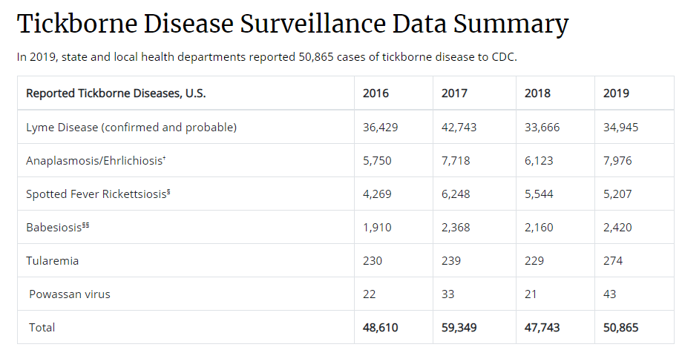
https://www.cdc.gov/ticks/data-summary/index.html

Slide 8
To give you an idea for comparison…
Total Disease Cases Reported in U.S. - 2019
Lyme | Anaplasmosis | Babesiosis
34,945 | 5,655 | 2,420
Reported Cases in U.S. in 2019 | Case Rate
Chlamydia trachomatis infection | = 551.0
Gonorrhea | = 187.8
Syphilis (total, all stages) | = 39.55
Campylobacteriosis | = 21.8
Salmonellosis | = 17.8
Shigellosis | = 5.7
Tuberculosis | = 2.7
Vibriosis | = 0.9
Tetanus | = 0.01
= 10.7 | = 1.8 | = 0.9
Annual US rate = Cases/100,000 population
Lyme Cases Reported, Pennsylvania - 2019
Confirmed | Probable | Total
6,763 | 2,235 | 8,998
https://wonder.cdc.gov/nndss/static/2019/annual/2019-table1.html
Annual US rate = Cases/100,000 population

Slide 9
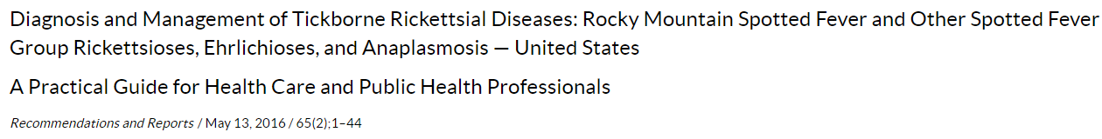
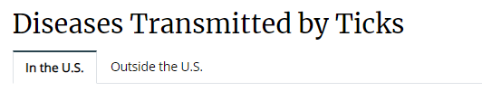
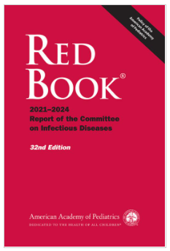
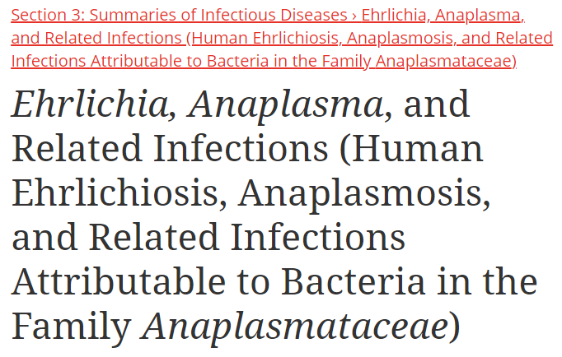
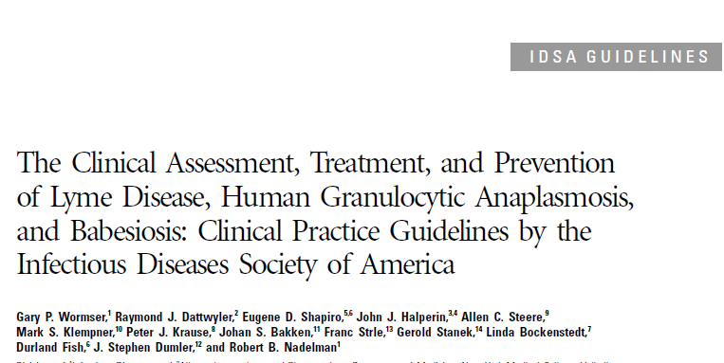
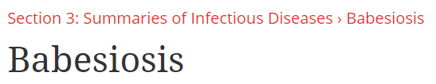
Anaplasma, Ehrlichia and Babesia
AAP Red Book 2021
https://www.cdc.gov/ticks/diseases/index.html

Slide 10
Anaplasmosis, Ehrlichiosis and Babesiosis
 | Anaplasmosis | Ehrlichiosis | Babesiosis
Tick Reservoir Causative agent | Ixodes scapularis White-tailed deer, rodents A. phagocytophilum | Amblyomma americanum White-tailed deer, rodents E.chaffeensis, Ehrlichia ewingii, Ehrlichia muris-like agent | Ixodes scapularis White-footed mouse B. microti
Epidemiology | 8 cases/million pop Under-recognized Upper Midwest and NE US (eg, Wisconsin, Minnesota, Connecticut, NY), northern CA Tick, Blood transfusions | 3.8 cases/million pop Under-recognized South central and southeastern US, and East Coast states Tick, Blood transfusions | Northeast (particularly Connecticut, Massachusetts, NJ, NY, RI) and upper Midwest (Wisconsin and Minnesota) Tick, Blood transfusions
Incubation | 5 – 21 days | 5 – 14 days | 1 – 5 wks (tick) 1 – 9 wks (transfusion)
Non-specific Sx | Fever, systemic illness, flu-like; can include GI sx, joint pain | SAME Rash more common (up to 60% of children) | Fever, flu-like illness, ↑HR Less common: URI, pharyngitis, cough, CNS
Specific Sx | Severe disease may include neurologic changes, DIC, ARDS, hemorrhage, renal failure | SAME, although usu more severe than Anaplasma | Dark urine, jaundice, mild hepatosplenomegaly

Slide 11
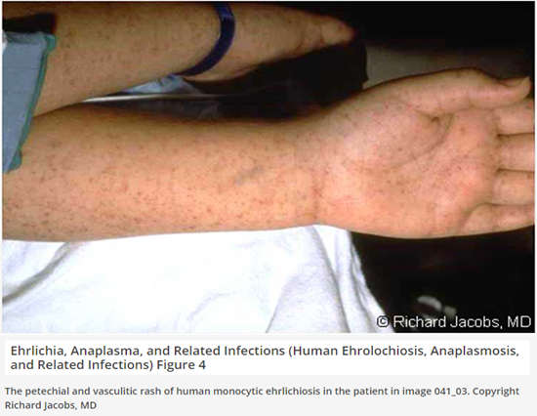
Anaplasmosis, Ehrlichiosis and Babesiosis
 | Anaplasmosis | Ehrlichiosis | Babesiosis
Tick Reservoir Causative agent | Ixodes scapularis White-tailed deer, rodents A. phagocytophilum | Amblyomma americanum White-tailed deer, rodents E.chaffeensis, Ehrlichia ewingii, Ehrlichia muris-like agent | Ixodes scapularis White-footed mouse B. microti
Epidemiology | 8 cases/million pop Under-recognized Upper Midwest and NE US (eg, Wisconsin, Minnesota, Connecticut, NY), northern CA Tick, Blood transfusions | 3.8 cases/million pop Under-recognized South central and southeastern US, and East Coast states Tick, Blood transfusions | Northeast (particularly Connecticut, Massachusetts, NJ, NY, RI) and upper Midwest (Wisconsin and Minnesota) Tick, Blood transfusions
Incubation | 5 – 14 days (maybe up to 21 days) | 5 – 14 days | 1 – 5 wks (tick) 1 – 9 wks (transfusion)
Non-specific Symptoms | Fever, systemic illness, flu-like can include GI sx, joint pain Rash not common (possible in children) | Fever, systemic illness, flu-like can include GI sx, joint pain Rash can occur (up to 30-60% of children) | Fever, flu-like illness, ↑HR Less common: URI, pharyngitis, cough, CNS
More specific Symptoms | Severe disease may include neurologic changes, DIC, ARDS, hemorrhage, renal failure | Severe disease may include neurologic changes, DIC, ARDS, hemorrhage, renal failure Can be more severe than Anaplasma | Dark urine, jaundice, mild hepatosplenomegaly Malaria-like illness, can be life-threatening

Slide 12
Anaplasmosis, Ehrlichiosis and Babesiosis
 | Anaplasmosis | Ehrlichiosis | Babesiosis
Lab abnormalities | ↑transaminases, ↑CRP ↓WBC, ↓Plts, ↓Na CSF abnormalities not uncommon | ↑transaminases, ↑CRP ↓WBC, ↓Plts, ↓Na CSF abnormalities not uncommon | Anemia, ↓Plts DIC can occur
Diagnosis | Whole blood PCR Serology Smear with morulae (cluster of organism) – less common | Whole blood PCR Serology | Blood smear (Maltese-cross forms) CDC – molec & serologic
Treatment | 5 – 10 days, continue at least 3 days after defervesce Doxycycline (PO preferred) | SAME | 7-10 days total Clinda + PO Quinine OR Atovaquone + azithro Consider exchange transfusion if parasitemia >10% or severely ill
Follow-up | Fatigue very common | Neurologic sequalae Fatigue very common
Notes | <1% case fatality TMP/SMX may worsen disease, increase death | E. chaffeensis – 1-3% case fatality TMP/SMX may worsen disease, increase death | Asplenic patients higher risk for severe disease Congenital infection

Slide 13
Anaplasmosis, Ehrlichiosis and Babesiosis
 | Anaplasmosis | Ehrlichiosis | Babesiosis
Lab abnormalities | ↑transaminases, ↑CRP ↓WBC, ↓Plts, ↓Na CSF abnormalities not uncommon | ↑transaminases, ↑CRP ↓WBC, ↓Plts, ↓Na CSF abnormalities not uncommon | Anemia, ↓Plts DIC can occur
Diagnosis | Blood PCR Serology Smear with morulae (cluster of organism) – less common | Blood PCR Serology | Blood PCR Blood smear (Maltese-cross forms) CDC – molec & serologic
Treatment | 5 – 10 days, continue at least 3 days after defervesce Doxycycline (PO preferred) | 5 – 10 days, continue at least 3 days after defervesce Doxycycline (PO preferred) | 7-10 days total Clindamycin + PO Quinine OR Atovaquone + azithro Consider exchange transfusion if parasitemia >10% or severely ill
Follow-up | Fatigue common | Neurologic sequalae Fatigue common
Notes | <1% case fatality TMP/SMX may worsen disease, increase death | E. chaffeensis – 1-3% case fatality TMP/SMX may worsen disease, increase death | Asplenic patients higher risk for severe disease Congenital infection
DO NOT WAIT for test result if considering Anaplasma or Ehrlichia – just TREAT

Slide 14
Anaplasmosis, Ehrlichiosis and Babesiosis
 | Anaplasmosis | Ehrlichiosis | Babesiosis
Lab abnormalities | ↑transaminases, ↑CRP ↓WBC, ↓Plts, ↓Na CSF abnormalities not uncommon | ↑transaminases, ↑CRP ↓WBC, ↓Plts, ↓Na CSF abnormalities not uncommon | Anemia, ↓Plts DIC can occur
Diagnosis | Blood PCR Serology Smear with morulae (cluster of organism) – less common | Blood PCR Serology | Blood PCR Blood smear (Maltese-cross forms) CDC – molec & serologic
Treatment | 5 – 10 days, continue at least 3 days after defervesce Doxycycline (PO preferred) | 5 – 10 days, continue at least 3 days after defervesce Doxycycline (PO preferred) | 7-10 days total Clindamycin + PO Quinine OR Atovaquone + azithro Consider exchange transfusion if parasitemia >10% or severely ill
Follow-up | Fatigue common | Neurologic sequalae Fatigue common
Notes | <1% case fatality TMP/SMX may worsen disease, increase death | E. chaffeensis – 1-3% case fatality TMP/SMX may worsen disease, increase death | Asplenic patients higher risk for severe disease Congenital infection
DO NOT WAIT for test result if considering Anaplasma or Ehrlichia – just TREAT

Slide 15
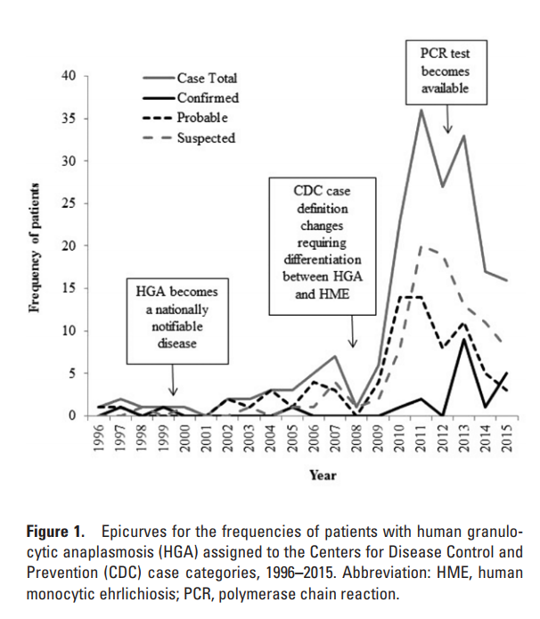

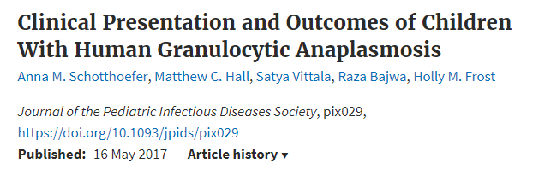
Anaplasmosis in Children
Study
Marshfield Clinic Health System (MCHS)
Northern Wisconsin, >50 clinic sites
EMR billing database query + lab result query, with subsequent retrospective chart review
1994 and 2015, children <19 yrs of age
Results 232 patients with possible HGA
  187 (81%) patients included
  17 (9%) met the CDC definition for confirmed infection
  75 (40%) probable infection
  91 (49%) suspected infection
1996 – 2009: Median HGA cases / year = 2 (range, 0–7)
2010 – 2015: Median HGA cases / year = 25 (range, 16–36)

Slide 16
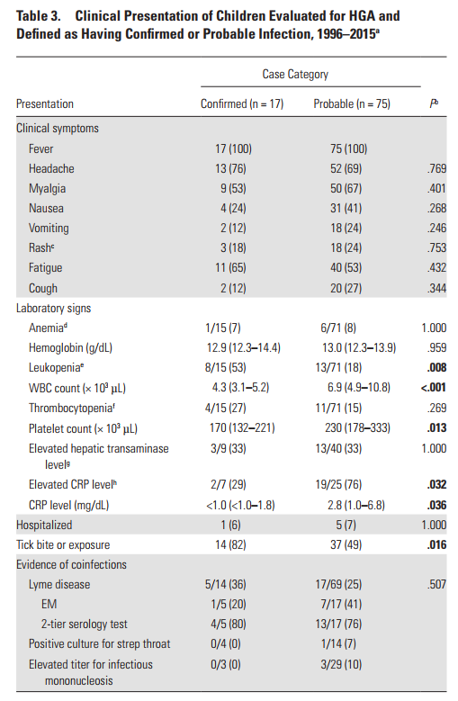
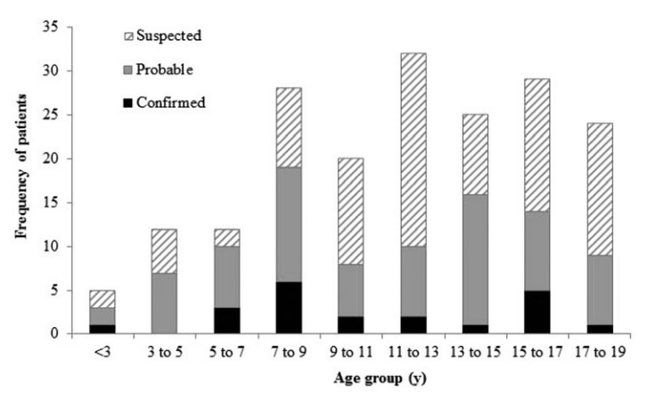
Anaplasmosis
27% (22/83)
of Anaplasma cases had
co-infection with Lyme in this study
Figure 2. Age distributions of patients with human granulocytic anaplasmosis within each Centers for Disease Control and Prevention case category.

Slide 17
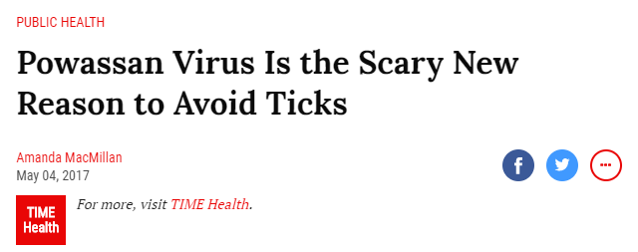
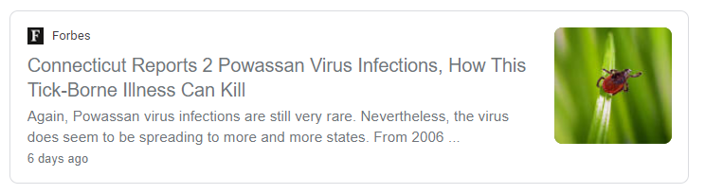
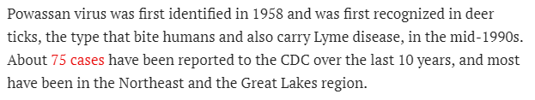
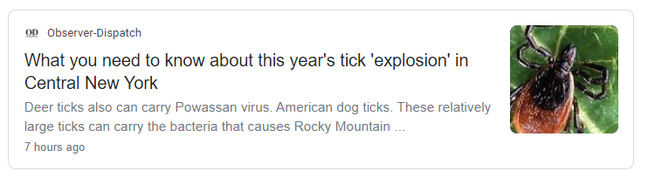




Powassan Virus

Slide 18
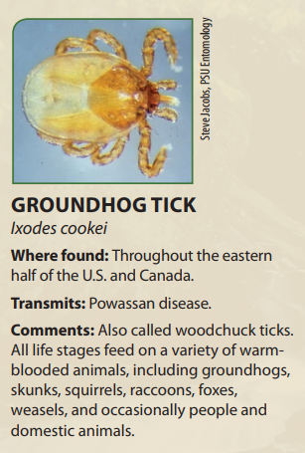
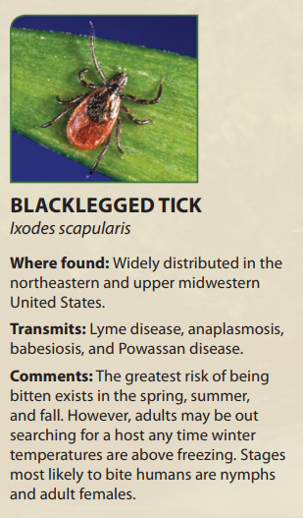
Powassan Virus
Symptoms
Could be asymptomatic/minimal symptoms
Milder disease: ? Fever, headache, vomiting, generalized weakness
Severe disease: May progresses to meningoencephalitis
  meningeal signs, altered mental status, seizures, aphasia, paresis, movement disorders, CN palsies
Labs and Studies
CSF findings
  Lymphocytic pleocytosis usu < 500 WBC CSF
  Protein usu normal or mildly elevated, Glucose normal
EEG: generalized slow wave activity, can mimic HSV encephalitis
Brian MRI: microvascular ischemia or demyelinating disease in the parietal or temporal lobes
Diagnosis
Serum IgM testing – only done at CDC
Results available 4 to 14 days after specimen receipt

Slide 19
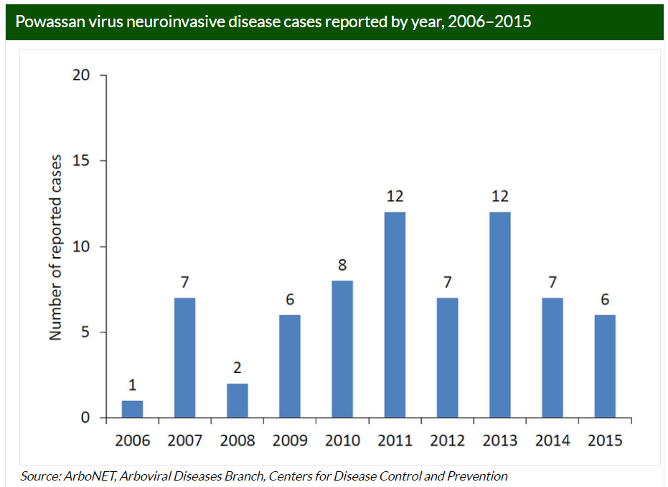

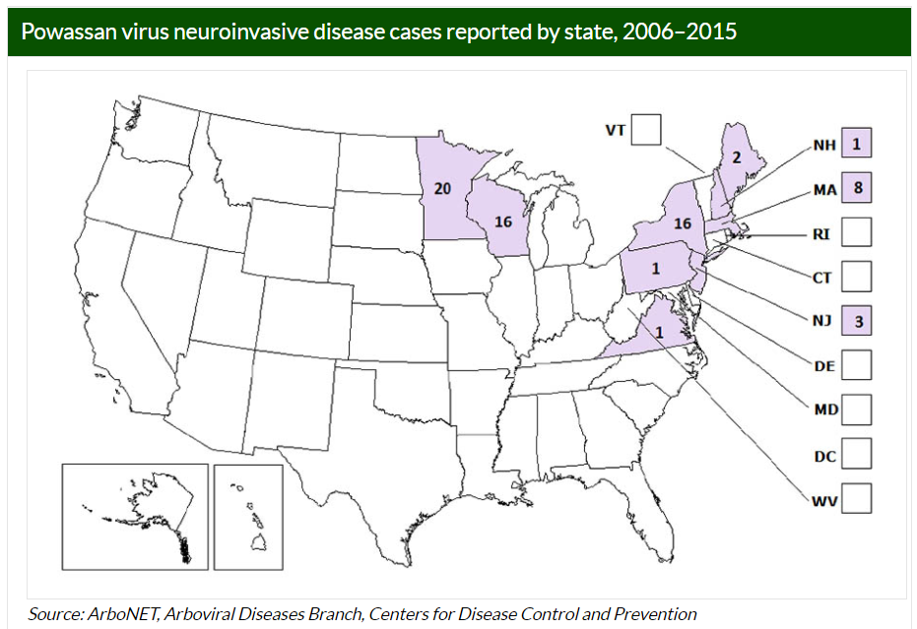
Powassan Virus
NOTE: ALL RESULTS WILL BE SENT TO THE APPROPRIATE STATE HEALTH DEPARTMENT. Notify your state health department of any submissions to CDC

Slide 20

Lyme Infection (Disease) in Children

Slide 21
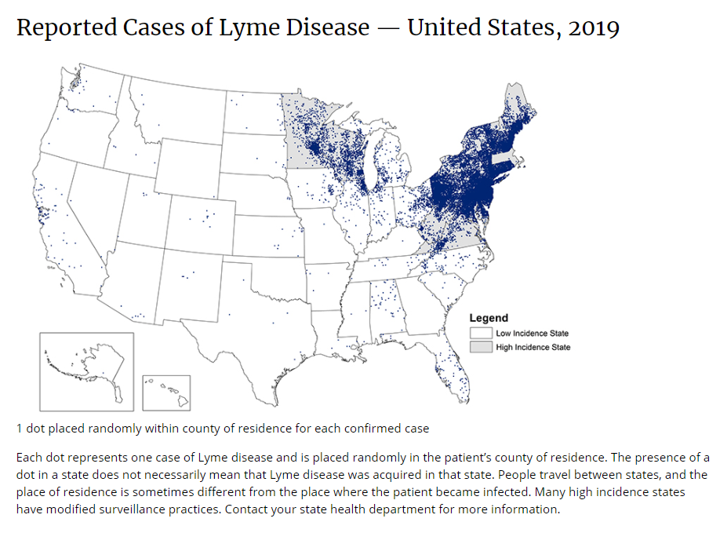
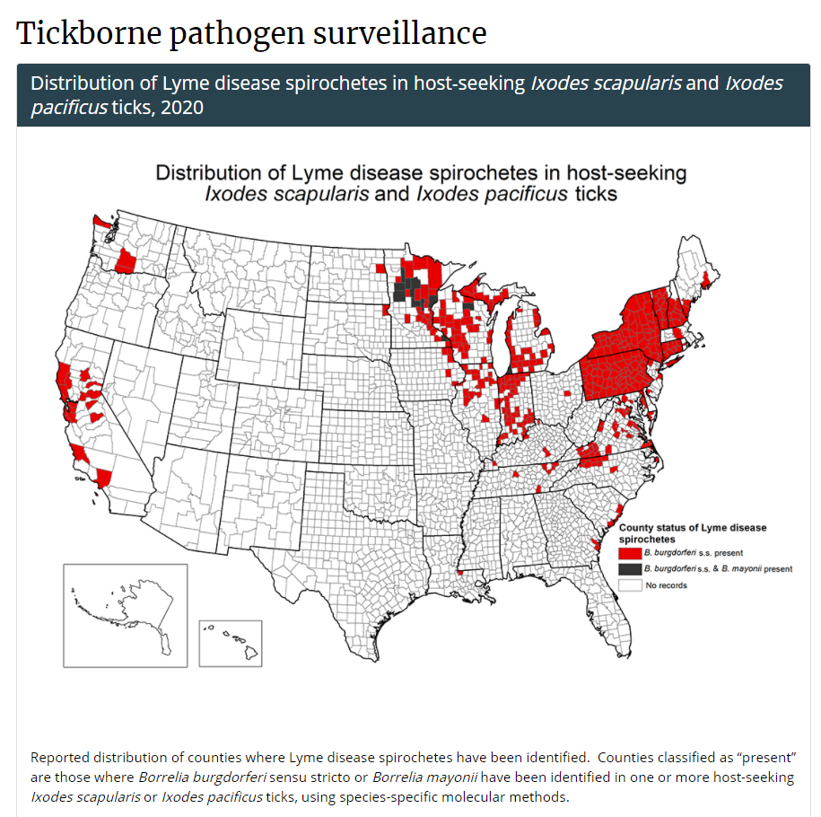
www.cdc.gov/lyme/datasurveillance/maps-recent.html
https://www.cdc.gov/ticks/surveillance/TickbornePathogens.html
>400,000 confirmed US cases, 1995 – 2015
8000 – 9000+ confirmed cases in Pennsylvania each year in 2017, ’18 & ‘19
~30% of confirmed Lyme cases occur in children <15 yrs of age

Slide 22
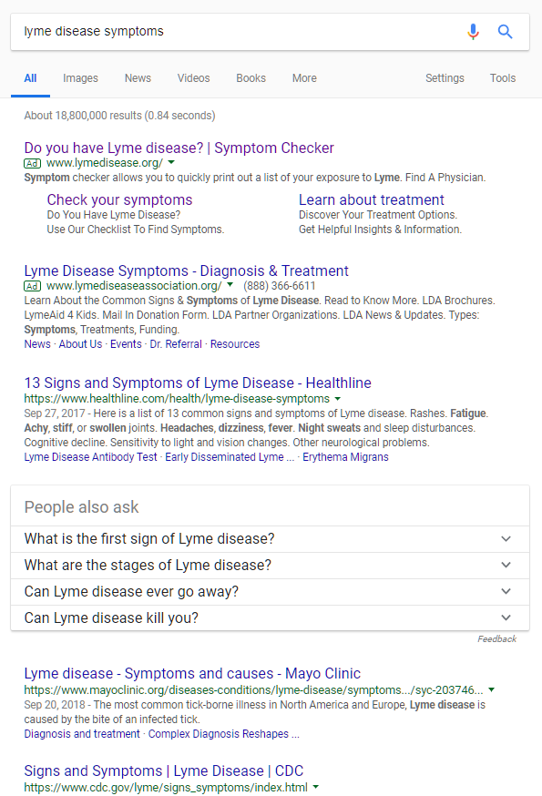
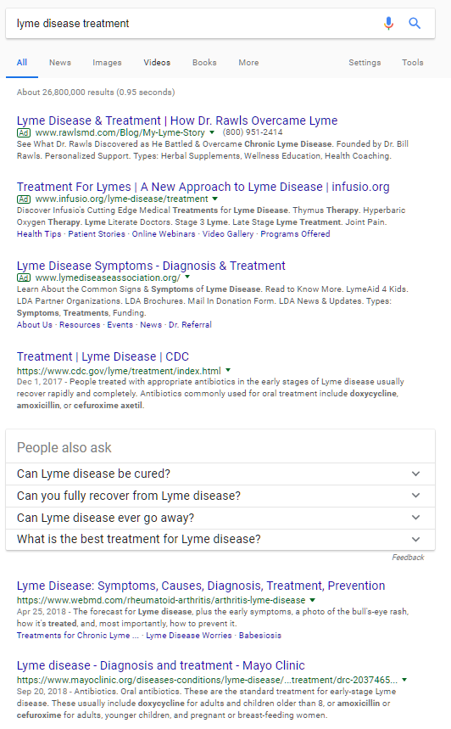
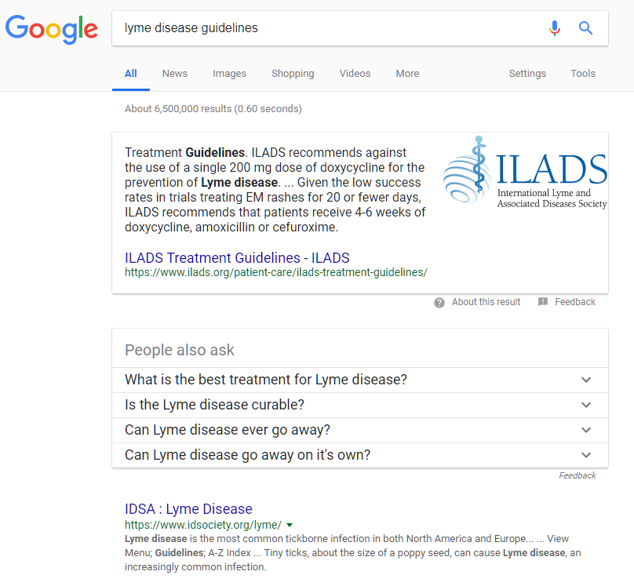
Internet searching can be misleading…

Slide 23
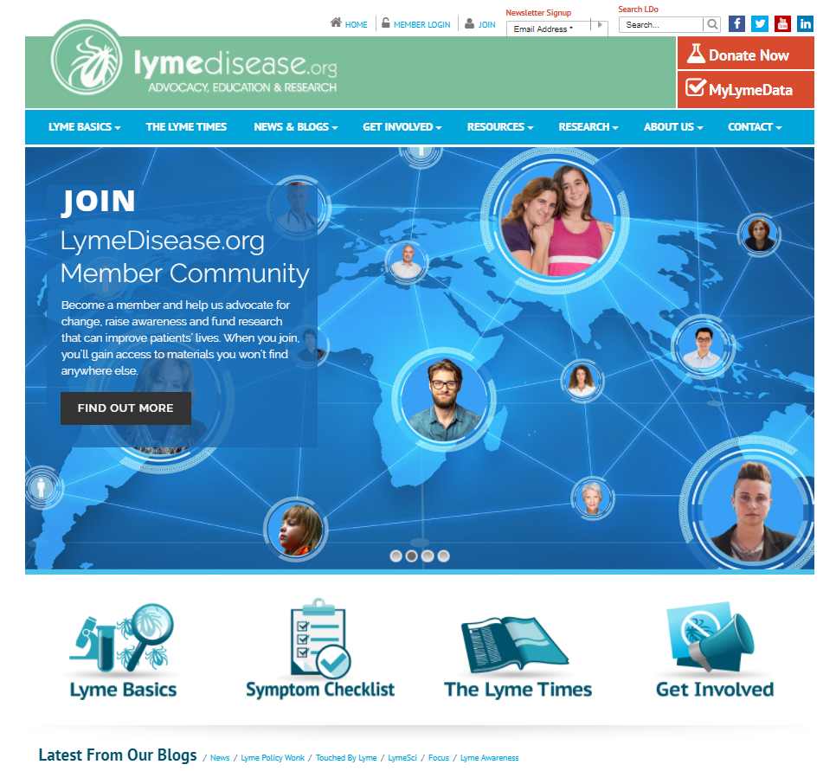
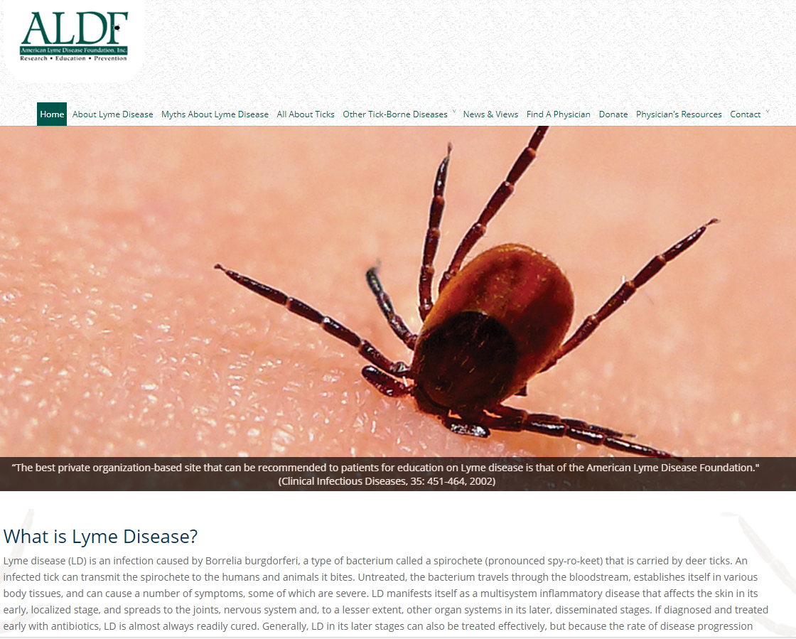
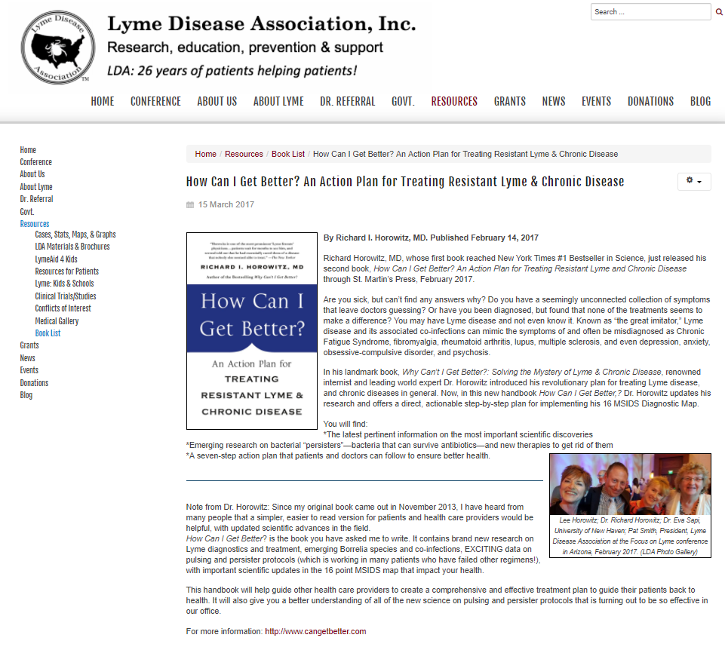
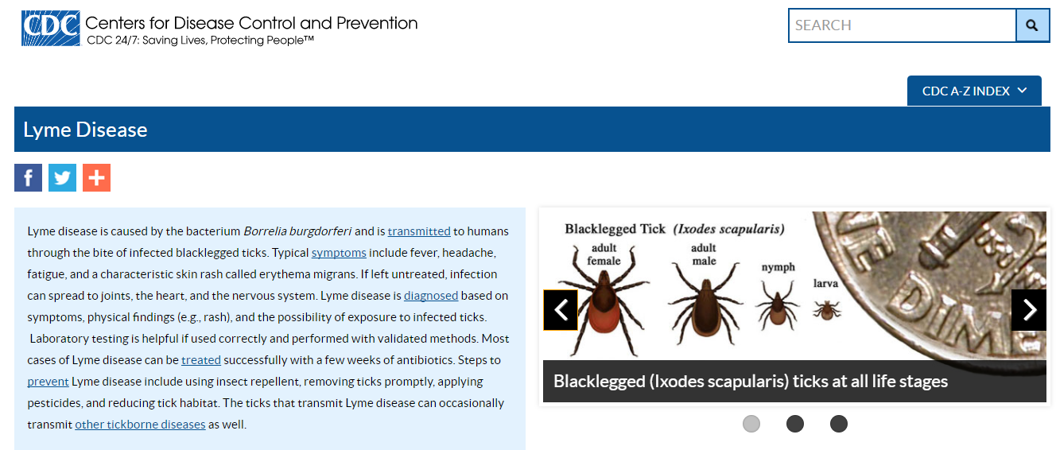
LYME DISEASE on the Internet

American Lyme Disease Foundation, Inc.




Slide 24
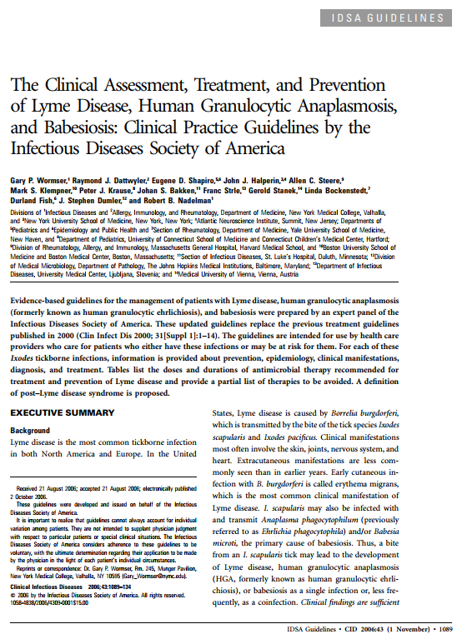
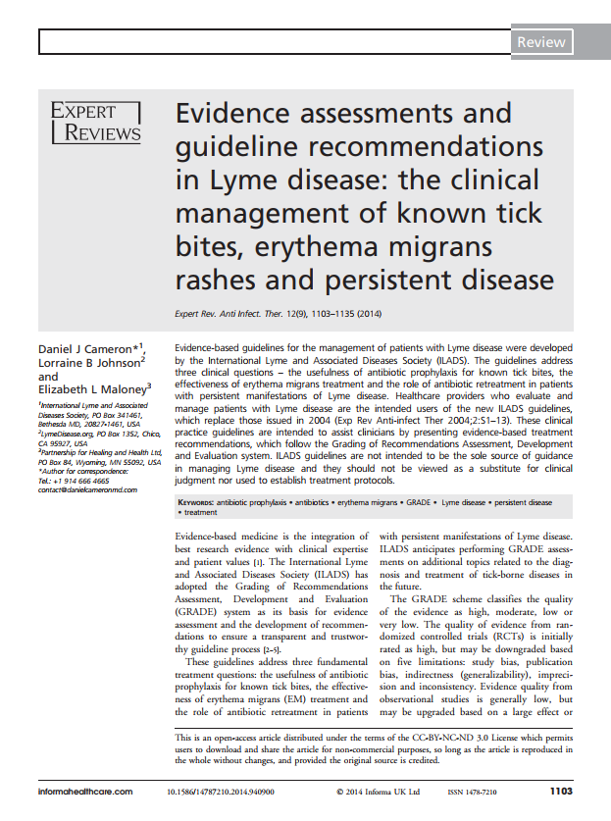
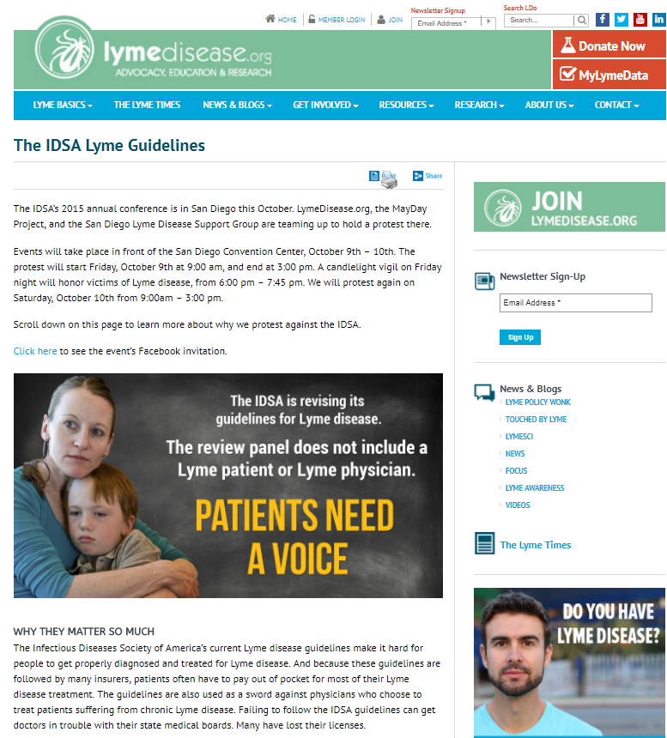
LYME DISEASE Articles


Medical Science
NOT Science

Slide 25
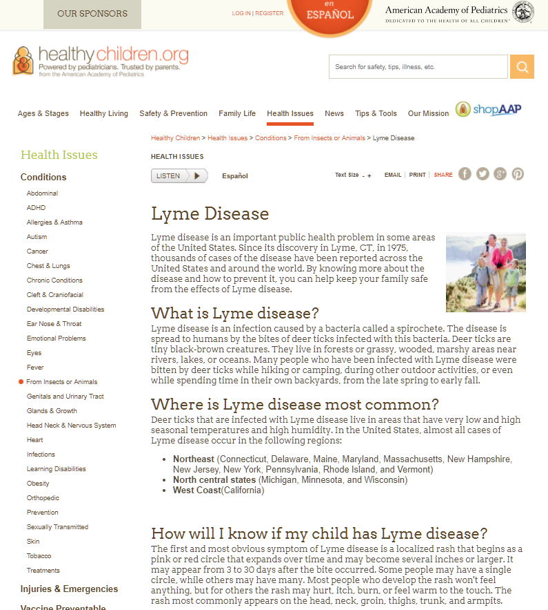
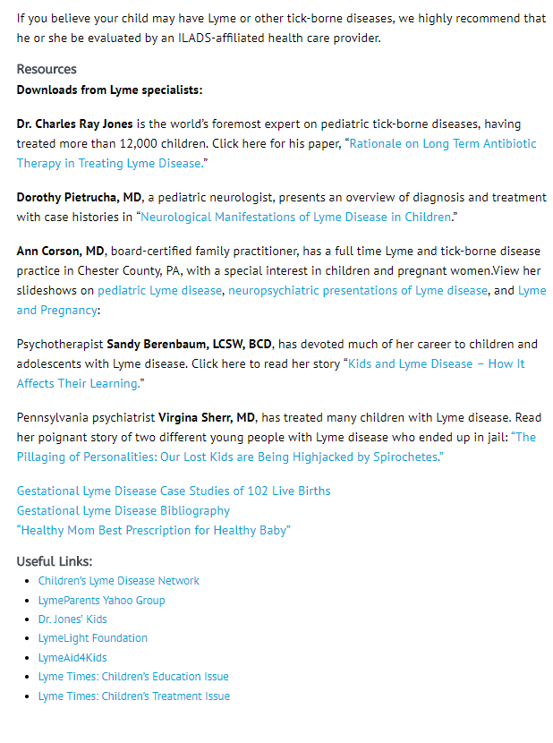

LYME DISEASE RESOURCES
www.lymedisease.org/lyme-basics/lyme-disease/children

Slide 26
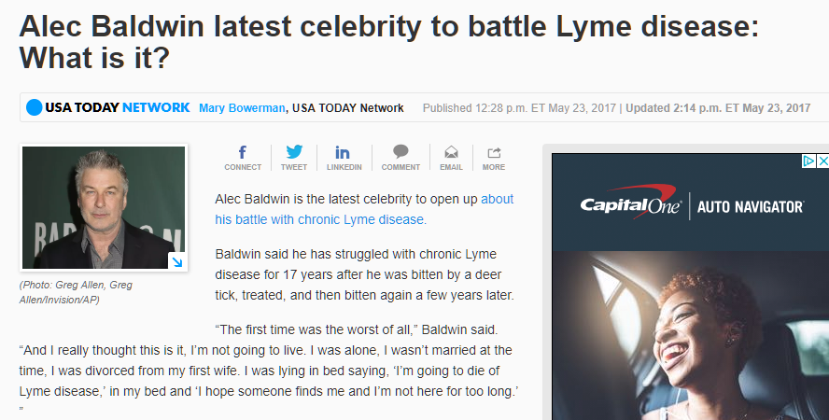
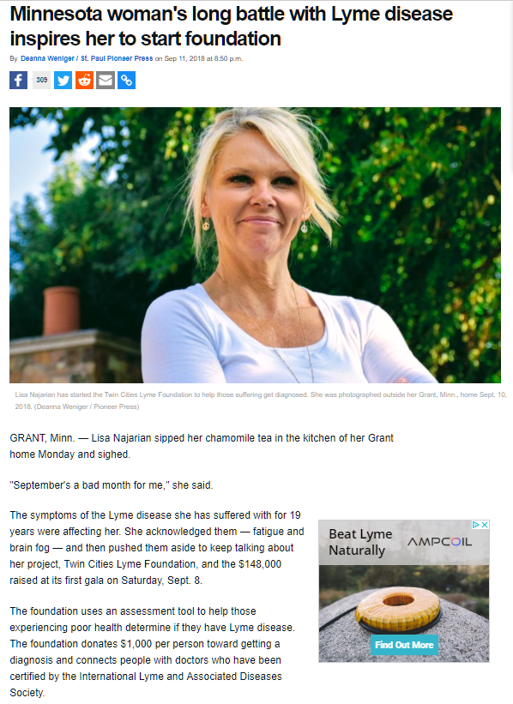
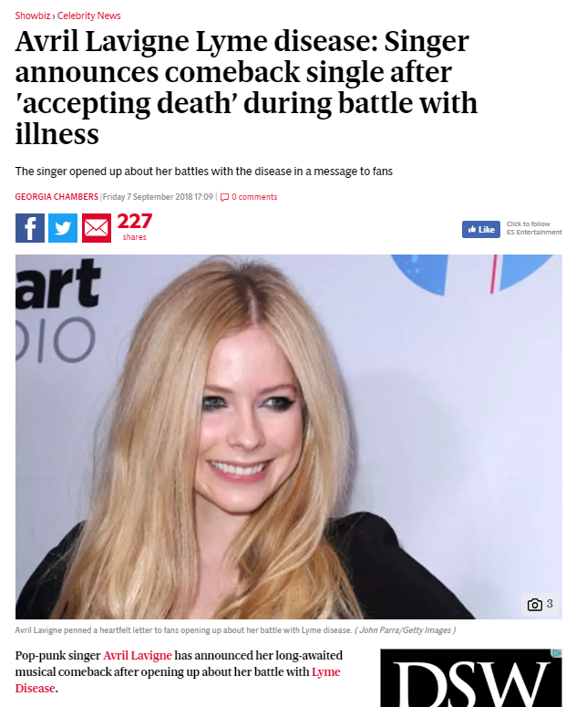
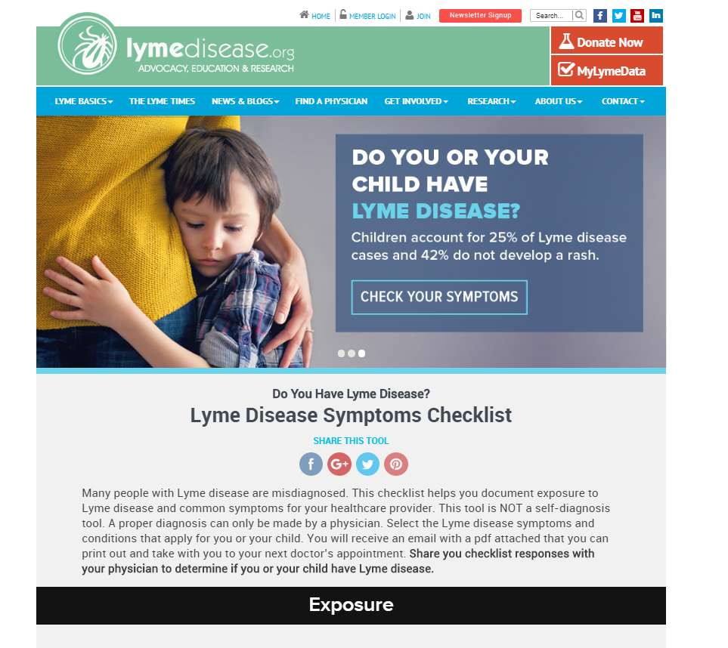


Navigating distorting headlines on the internet is very challenging…
Social media
Blog/vlog posts
Community and religious groups
Support groups
Very challenging for people to not go down internet rabbit holes…

Slide 27
Helping patients and families can also be challenging…
Patients can have real symptoms that have been wrongly associated with Lyme infection as the cause.
Propagating wrong information, treating patients with antibiotics “just in case” and/or not discouraging them from seeing people who claim to be “lyme literate” will do HARM to patients and families.
Accurate knowledge + Empathy
are so important.
Time – longer visits, more visits
Empathy – this is hard and scary for patients and families
Knowledge – Science and not science
Medical care – Medical evaluations and referrals, as appropriate
Support – Provide reassurance and support, as appropriate
Empathy – meet the family where they are, they may have feelings of anger, embarrassment, sadness, anxiety surrounding misleading path and/or inappropriate management

Slide 28
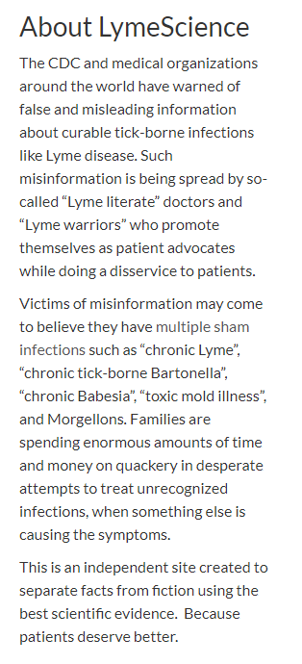
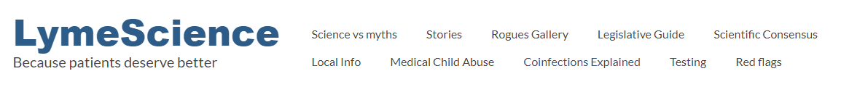
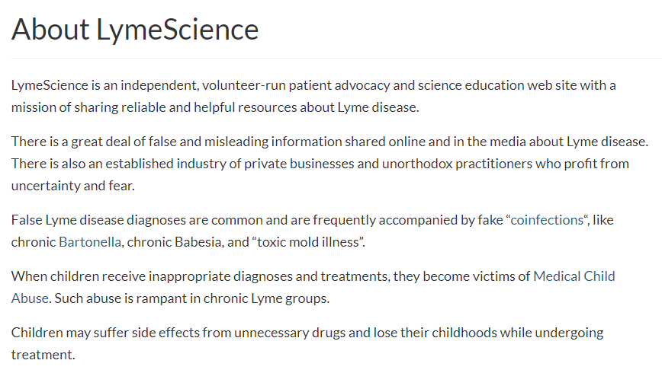
Legitimate website, medical science-backed information
https://lymescience.org/

Slide 29
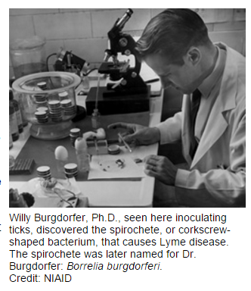
LYME DISEASE | Historical Perspective
1975 – unusually high number of children with new diagnosis of JRA
1977 – Allen C. Steere, MD suggested the deer tick as a possible vector
1981 – Dr. Burgdorfer connects the dots using information from a 1949 conference plus his work with Dr. Benach studying Rocky Mountain Spotted Fever.
He tested serum samples and assessed antibody
responses to the spirochetes found in deer ticks
June 1982 – Publication in Science describing the spirochete now known as B. burgdorferi as the causative agent of Lyme Disease
www.niaid.nih.gov/topics/lymeDisease

Slide 30
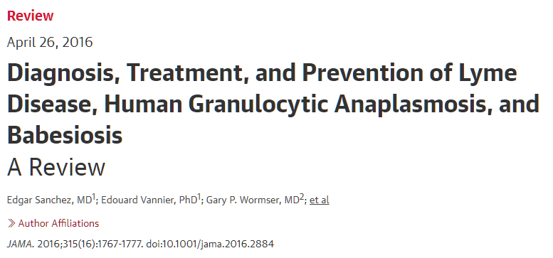

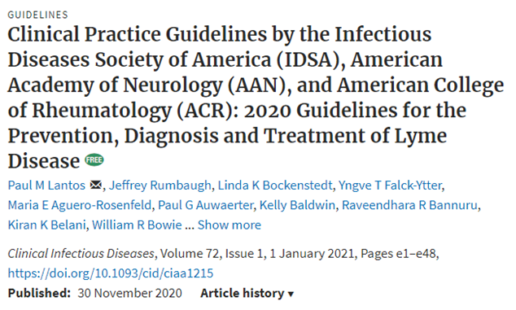



Medical Resources
https://academic.oup.com/cid/article/72/1/e1/6010652

Slide 31



Slide 32
Early Localized Disease
Erythema migrans
  Incubation 1-32 d after tick bite (mean 10-11 days)
  Occurs at site of tick bite
  Expanding skin lesion, ≥5cm
  May be plaque-like rather than classic “bull’s eye”
  May have less common features such as necrotic center, crusting, mild pruritus, mild pain or tenderness
  Can occur anywhere on body
  Most common head/neck
  Fever/constitutional symptoms may occur briefly

Slide 33

Early Localized Disease
CDC and DermAtlas
Sood. Infect Dis Clin N Am 2015

Slide 34


Not Lyme
Insect bite hypersensitivity
Fixed Drug reaction
Ringworm
Pityriasis rosea
Granuloma annulare
Urticaria multiforme
https://www.cdc.gov/lyme/signs_symptoms/rashes.html

Slide 35
Early Disseminated Disease
Multiple EM lesions
Neuroborreliosis
Most common form of dissemination in children
+/- fever, constitutional symp, arthralgias, myalgias
Cranial nerve palsies
Meningitis
  Papilledema
Polyradiculopathies
www.CDC.gov
Variable Clinical Presentation
Multiple EM lesions
Neuroborreliosis
Carditis
Carditis
1st, 2nd, or 3rd degree AV block
Bundle branch block
  Usually occurs with EM or acute nervous system involvement
  If isolated, may have syncope or symptomatic heart block
Rare manifestations
  Myocarditis, myopericarditis, LV dysfunction or cardiomegaly
Centers for Disease Control and Prevention, 2018
Sood. Infect Dis Clin N Am 2015

Slide 36

Late
Disease
Arthritis
Usually monoarticular
  Often knee (as high as 85%)
  Shoulder, ankle, elbow, wrist, hip
  Can wax and wane if left untreated for weeks to months
  Can involve more than one joint if untreated
Swelling/effusion much greater than degree of illness
  May have pain and/or limited ROM, but less dramatic
  Usually has some weight-bearing capability
  Fever rarely if ever occurs
No long-term joint damage or consequence known with Lyme arthritis
Arthritis is most common late clinical presentation
Other clinical entities are rarely reported in children – unclear if truly related to Borrelia burgdorferi infection in children in the US
Encephalitis
Encephalopathy
Polyneuropathy
Centers for Disease Control and Prevention, 2018

Slide 37

What Lyme Disease is NOT
    Chronic fatigue
    Arthralgias and/or myalgias
    Non-specific or chronic headaches
    Non-specific visual changes
    Abnormal temperatures and/or sensations
    Poor appetite
    Non-specific GI symptoms
    Poor performance at school or in activities
    Weight loss
    Persistent or recurrent fever
    Persistent or recurrent lymphadenopathy
    Abnormal labs
      i.e. Anemia, transaminitis, elevated ESR, etc
Non-specific
chronic symptoms
= NOT Lyme
Pursue alternative diagnosis

Slide 38
Diagnosis of Lyme disease in pediatric patients
Diagnostic testing options

Slide 39

13 year old Caucasian female with 1 month history of right knee swelling and mild pain. ROM is moderately limited but she has continued to attend school. She is otherwise well.
You are considering Lyme disease – what tests will you order?
None – just assume the diagnosis because she lives in a Lyme-endemic region
None – will refer her to orthopedics and have them send Lyme PCR on the synovial fluid only
Blood tests: Lyme Western Blot – it is the most specific test
Blood tests: Lyme antibody EIA with reflexive Western blot

Slide 40
During the summer, you see a 9 year old with persistent worsening headache over the past 1 week, general fatigue and malaise, and low-grade fever. Over the last day, he has complained of intermittent blurry vision but has no other focal abnormalities.
Which of the following tests would you send to confirm your suspicion of Lyme meningitis?
Blood tests: Lyme EIA with reflex Western blot
CSF analysis with Lyme PCR
CSF analysis with Lyme IgM and IgG
Two of the above
All of the above

Slide 41


Slide 42


Inappropriate or invalid “lyme” testing
Follow CDC and AAP guidance. LymeScience.org is also a useful website.
https://www.cdc.gov/lyme/diagnosistesting/labtest/otherlab/index.html
https://lymescience.org/red-flags-of-lyme-quackery/
Red flag labs

Slide 43
Early Localized Disease
Antibody testing usually negative and thus not recommended
Convalescent testing 4-6 weeks later can be helpful in confirming the diagnosis sometimes
Some children who are treated early for EM will not mount a measurable antibody response
Culture and PCR can be done on skin biopsy from EM lesion, but are not routinely recommended due to invasive nature

Slide 44
Lyme Meningitis
In a child with meningitis:
“Rule of Sevens”
7 days of headache
>70% mononuclear cells in CSF
+/- 7th CN palsy
______________________________
77% likelihood of Lyme as etiology
of meningitis
Validated in study published in Pediatrics in 2012

Slide 45

Lyme Arthritis
Lyme EIA and Western blot positive in close to 100% of cases
PCR can be done on synovial fluid, but given reliability of blood tests,
it is not necessary
Arthrocentesis may be briefly therapeutic, but not necessary for resolution of effusion
Do NOT need synovial fluid to diagnose Lyme arthritis, but may need sample to diagnose other infections or conditions

Slide 46
Summary Points for Lyme Testing
Presentation | Should testing be done | Testing to Consider | Notes | Consider Co-infections
EM rash | NO - Testing likely NEGATIVE (too soon for antibody response to be measurable) | Consider acute and convalescent serology if unsure of diagnosis | Convalescent serology might be negative if treated very early and with mild sx to start | If used amoxicillin and patient continues to be or develops fever and/or systemic symptoms after 2-3 days on non-doxy tx
Early disseminated infection Multiple EM lesions Meningitis CN palsy Carditis | YES – Send serology but may be NEGATIVE (too soon for antibody response to be measurable) CSF PCR is poor – limited use (5-60% sensitivity) CSF antibodies can be used, but should be sent for and Index test (paired CSF and Serum ab) Do not send blood PCR | If serology initially NEGTATIVE, then can send convalescent serology 4 weeks later → usually will be positive if was Lyme, even if treated early Exclude other causes of carditis or meningitis | For meningitis “Rule of 7s” | If used amoxicillin and patient continues to be febrile or develops fever and/or systemic symptoms after 2-3 days on non-doxy treatment If routine lab abnormalities such as leukopenia, anemia, thrombocytopenia, hepatitis (Lyme does not cause these)
Lyme arthritis | YES – Serology is the standard and will be positive | Can send Lyme PCR on synovial fluid, but it is not needed in most cases to make dx | If Lyme serology is NEGATIVE, then pursue DIFFERENT diagnosis | If highly febrile and/or joint is very painful, consider septic arthritis or alternative diagnosis

Slide 47
Management of Lyme infection (disease) in pediatric patients
Treatment options

Slide 48

A 3-year-old male presents to your office with this skin lesion on his extremity. You decide to empirically treat him with an antibiotic, but he is severely allergic to amoxicillin (anaphylaxis).
What antibiotic do you prescribe?
Cefuroxime
Azithromycin
Doxycycline

Slide 49


2018 AAP Red Book Treatment recommendations for Lyme Disease in Children
Todd et al. J Pediatr. 2015;166:1246
No difference in shade, enamel or staining
with short courses
Med and Pharm records American Indian reservation with high RMSF
Dentists measured shade, enamel hypoplasia and staining perm teeth
58 children: 1.8 courses doxycycline < 8 yrs of age
213 children: never received doxycycline
Limited safety data on longer courses (>21 days) of doxycycline in children

Slide 50

2021 AAP Red Book Treatment recommendations for Lyme Disease in Children
a) Corticosteroids should not be given
NSAIDs & Consider rheumatology evaluation

Slide 51
17-year-old male athlete was treated for left knee Lyme arthritis (proven by appropriate testing) two months ago with 28 days of oral doxycycline.
He returns today with recurrent swelling and mild stiffness, but he is otherwise well.
Which of the following would you consider doing next?
Refer to orthopedics
Retreat with another course of 28 days of oral doxycycline
Retreat with a course of IV ceftriaxone
Try NSAIDs and reassess in 2-4 weeks
Perform more extensive rheumatologic evaluation

Slide 52

A few notes on Lyme Arthritis…
~10% to 15% of patients treated for Lyme arthritis will develop persistent synovitis that can last for mos to yrs
Pathophysiology - ? delayed resolution of inflammation because of slow clearance of nonviable bacteria following treatment versus an autoimmune mechanism
No predictors were identified (antibiotic use, time to initiation of abx, duration of sx prior to treatment, ANA result, or presence of EM)
Patients with persistent synovitis despite repeat treatment initially should be managed with NSAIDs.
More severe cases → Refer to peds rheumatologist,
May treat inflammation with intra-articular steroid injection
Methotrexate has been used successfully in some cases.
Arthroscopic synovectomy is required rarely for disabling or refractory cases.
Other studies postulate that HLA-DRB1, HLA-B27 antigens may predict prolonged symptoms
Persistent joint symptoms
  Up to 39% past 6 months
  Up to 13% ≥ 1 year

Slide 53

In the “Lyme” Light
Commonly asked questions
Tick is found embedded/engorged – should I give prophylaxis? If yes, with what?
Parent calls and states that a tick pulled from the child’s arm was sent for testing and is positive for “lyme and anaplasma.” What should I do next?
Child presents with rash that looks like classic erythema migrans, but had confirmed Lyme 3 years ago. Can this be Lyme again? What testing should I do, if any?
I just saw a patient for the first time, and the previous provider had sent repeat lyme
serology every 6 months to “monitor lyme disease.” The family wants me to continue to do that, as they believe that child has “chronic lyme.” What should I do?

Slide 54

CDC Prophylaxis guidance

Slide 55





thank you
Questions?
jvodzak@geisinger.edu

