Slide 1
Marijuana and the Pediatric Population: Weeding through the Weeds
Sheryl Ryan, MD
Professor of Pediatrics
Chief, Division of Adolescent Medicine,
Penn State Health Hershey Medical Center

Slide 2
Disclosures
I have no relevant financial relationships with the manufacturer(s) of any commercial product(s) and/or provider(s) of commercial services discussed in this CME activity.
I will be discussing investigational cannabis products in my presentation.

Slide 3
Objectives
Provide background on the biology of marijuana, cannabis products and the endocannabinoid system
Explain the acute, short-term, and long-term effects of marijuana use
Describe what is known about the effectiveness and safety of cannabis products in childhood medical conditions

Slide 4
Monitoring the Future Study: Marijuana – 2020 data
Slide from W Milchak, LCSW

Slide 5
Monitoring the Future Study: Marijuana Vaping – 2020 data
Slide from W Milchak, LCSW

Slide 6
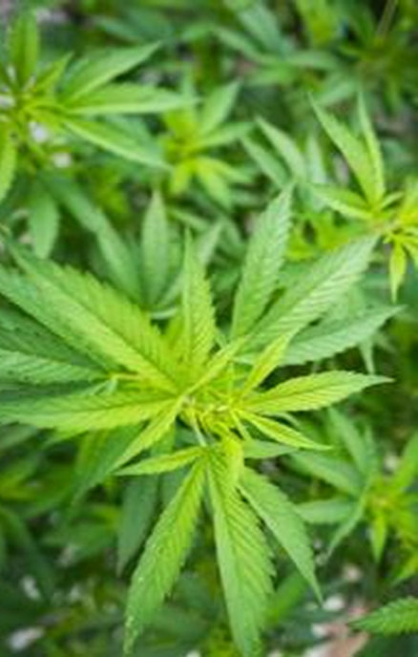
Terminology
Cannabis
Traditionally refers to the marijuana plant Cannabis sativa, Cannabis indica
THC: delta-9-tetrahydrocannabinol – the psychoactive substance
More than 400 compounds with > 100 types of biologically active cannabinoids
Terpines – immune modulators
Cannabis Oil /Concentrates
Extracts of cannabis plant – using solvents/nonsolvents – contain varying amounts of CBD, THC, terpenes
BHO (butane hash oil) – “wax”, “shatter”, “dabs”; hashish resin
Hemp – fiber form of cannabis
Has low concentration of CBD in leaves and flowers, but <1% THC
Major source of CBD - cannabidiol
CBD Oil/Extracts – generally higher concentrate of CBD, low THC
From hemp with added CBD from other sources
Made into creams, lotions, edibles
Edibles - Varying types and amount of either THC or CBD
Newer substances – CBG – cannabigol; THCV - vidabarin (terpenes), etc.

Slide 7
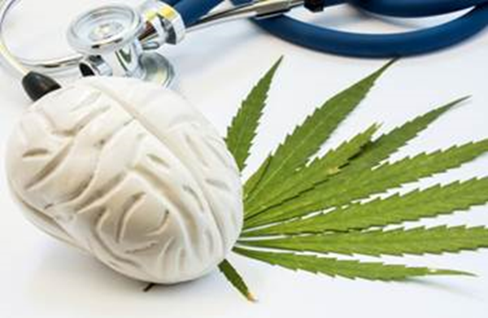
Marijuana Biology
Delta 9 –Tetrahydrocannabinol - THC
The primary psychoactive cannabinoid in the marijuana plant.
High affinity for CB receptors in the brain
Selective breeding has resulted in higher concentrations of THC in plant products
From 1995 to now - ~4% to >20% THC
Much lower concentrations of CBD
New ways of using (dabbing, volatilizing oils) create even higher concentrations – 39-80%
More potent psychotropic effects as well as increased risk of adverse effects

Slide 8
Marijuana Strength

Slide 9
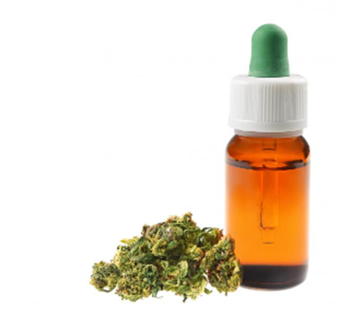
Cannabidiol (CBD)
CBD - non-psychoactive cannabinoid.
Low affinity for CB receptors in the brain
antagonist, potentiates CB receptors
Can interfere with endocannabinoid degradation;
Agonist of serotonin 5HT1A receptors → neuroprotection?
Potent antioxidant and anti-inflammatory
Focus on CBD for medical effects
Less is known about dose-response relationships of CBD and mechanisms of action for specific conditions

Slide 10
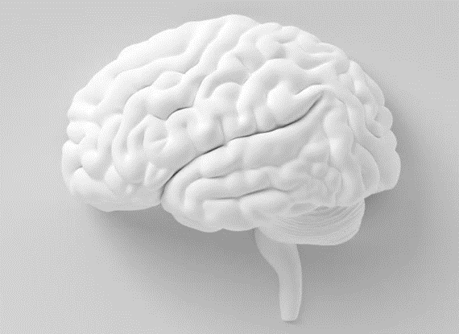
The Endocannabinoid System: ECS
Humans produce “endocannabinoids”
Anandamide and 2-AG (2-arachidonoylglycerol).
Biologically active molecules that serve a number of regulatory functions.
Regulates appetite, immune suppression, pain management
Two endocannabinoid receptors: CB1 and CB2.
CB1 - in the brain and nervous system
CB2 - in immune system cells, wide range of somatic cells.
Can be detected as early as 5 weeks gestation
THC from marijuana binds readily to CB receptors
Partial agonist with biologic activity
CBD binds weakly to CB receptors

Slide 11
Why is the ECS important?
Critical for early neonatal brain development
Mechanism still being elucidated
Role in microtubule function -→ axonal growth
Involved in orderly fetal development of neural systems
THC from marijuana crosses placental readily
Binds to CB receptors in brain
Concern that THC “highjacks” or disrupts this highly sequenced pattern of normal neuronal development
Underlying mechanism for neurodevelopmental deficits seen in infants and children whose mother used marijuana during pregnancy?

Slide 12
BRAIN RECEPTORS

Slide 13
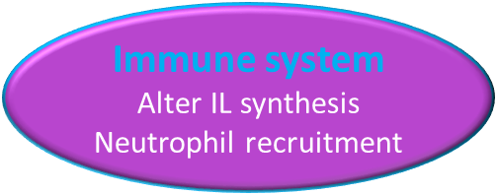
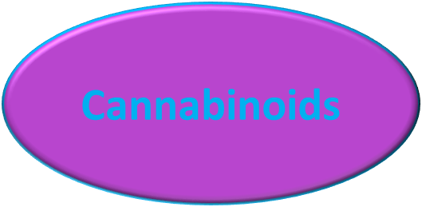
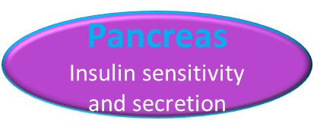
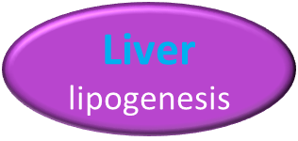
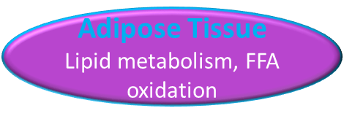
Cannabinoid Sites of action

Slide 14
ECS – Importance IN adolescence
Few human studies - need to rely on Preclinical data
ECS has dynamic role re: brain development in adolescence
Brain development characterized by increase in white matter, decrease in gray matter – pruning, efficiency
Especially in areas associated with reward, motivation and cognition
CB1 receptor density increases in these areas during adolescence compared with adult brain
THC found to affect density of CB receptors, and activity of neurotransmitters, GABA and glutamate
Concern that THC disrupts “perfectly orchestrated” maturation
Unclear how brain maturation may be affected, trajectory of effects
Unclear implication in humans
Long-term effect of THC on brain structure and neuronal systems not well described

Slide 15
Short and Long Term Effects of marijuana

Slide 16
Acute Effects
Intoxication
Euphoria, relaxation/sedation, change in pain sensation, distortion of sensory perception, thought and time distortion
Delayed motor coordination, slowed reaction to stimuli
Increased heart rate; decreased blood pressure
4.8 fold increase in chance of having a heart attack within 1st hour after using drug (
Cough, blood-shot eyes
Hallucinations, paranoia, anxiety, psychosis
Memory Impairment
Excessive vomiting – generally with heavy use

Slide 17
Effects with Regular Use
Dependence in 1 in 6 teens who use regularly
Craving, tolerance leads to increased usage over time
Withdrawal symptoms
DSM V Diagnosis – marijuana use disorder
Psychotic symptoms and disorders in heavy users
Especially with family history of psychosis
Chronic bronchitis and impaired respiratory
50-90% more car accidents when also used with alcohol
Higher rates of use of tobacco and other drugs
Hyperemesis syndrome

Slide 18
EVALI – E-cigarette-Vaping Lung Injury
As of February 2020 – 2,758 cases reported to the CDC
64 deaths
Symptoms
Acute respiratory illness – cough, chest pain, SOB, hypoxemia
Nonspecific symptoms, GI symptoms
Culprit
Vitamin E Acetate found in products used and in lung fluids
Seen primarily with teens adding THC products to vaping system
THC obtained from “informal sources and on-line”
In-patient treatment using steroids most helpful
Source: CDC.gov

Slide 19
Long Term Effects
Short-term memory impairment that is long lasting
Likely permanent cognitive impairment and loss of IQ in adolescents who begin use at an early age and continue heavy use into late adolescence
Poorer psychosocial development
Impaired educational attainment in adolescents who are regular users
Amotivational syndrome
Unclear association with respiratory diseases
Higher rates of schizophrenia, anxiety and mood disorders

Slide 20
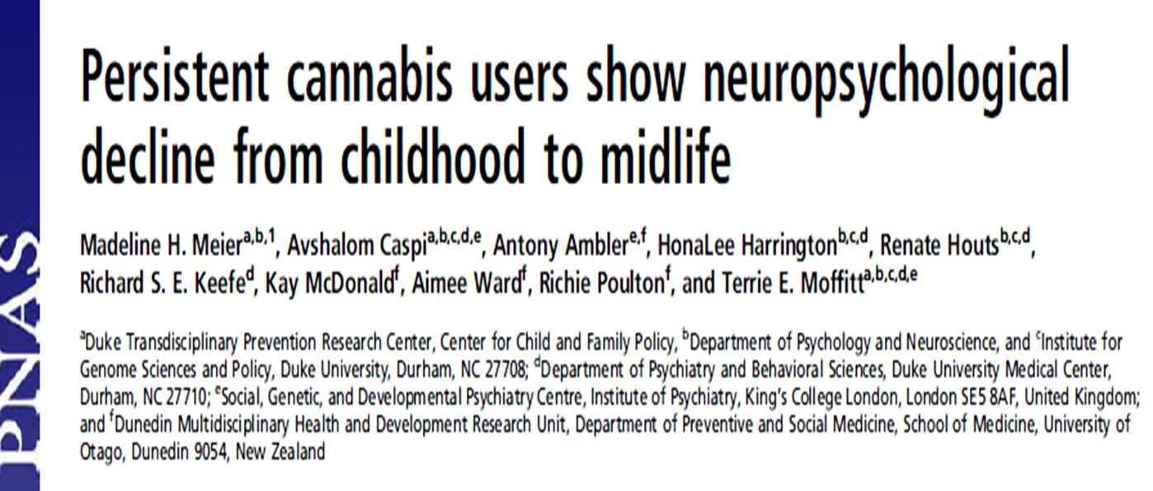
Source: Meier et al. Proceedings of the National Academy of Sciences. 2012. Available at: www.pnas.org/cgi/doi/10.1073/pnas.1206820109

Slide 21
Mj dependent 3+ yrs
Mj dependent 2 yrs
Average IQ change:
“Never used”
99.8 to 100.6
“Mj dependent 3+ yrs”
99.7 to 93.9
Mj dependent 1 yr
Used, never diagnosed
Never used
Source: Meier et al. PNAS, 2012

Slide 22
ASSOCIATION BETWEEN CANNABIS USE AND SCHIZOAFFECTIVE DISORDER
 | # Exposure | # Cases | HR Crude | HR adjusted*
Never used cannabis | 39, 978 | 47 | 1 | 1
Ever used cannabis | 5,109 | 12 | 2.1 (1.1-3.8) | 0.8 (.2-2.9)
>50 times | 855 | 7 | 7.5 (3.4- 16.7) | 7.4 (1.0 – 54.3)
* Adjustments for: prior personality disorders at conscription, IQ, disturbed behavior in childhood, social adjustment, risky use of alcohol, smoking, early adulthood socioeconomic position, use of other drugs, brought up in a city. The category “Ever used cannabis” includes all individuals who reported cannabis use, including those who reported “>50 times”.
Manrique-Garcia, BMC Psychiatry. 2012: 12; 112.,,12, 112.

Slide 23
Developmental effects associated with prenatal cannabis exposure
Birth
Increased tremor, exaggerated startle, lower birth weights
Childhood
Impaired verbal, abstract, visual and quantitative reasoning, short-term memory, and attention,
Increased impulsivity and hyperactivity
Adolescence/Young Adulthood
Increased risk of using marijuana, altered neuronal functioning during visuospatial memory tasks, increased neural activity in PFC during inhibitory control tasks
Concerns that effects seen are confounded by additional substances used by mother prenatally – i.e. tobacco and alcohol, other substances.
Source: Morris CV, DiNieri JA et al European J of Neuroscience, 2011, 34: 1574-1583.

Slide 24
What about K2/Spice?
Synthetic cannabinoid-like compounds
Diverse group of pharmacologic agents – agonists/partial agonists at CB1 receptors
Cyclohexylphenols, JWH-250, fatty acids similar to oleamide
Sprayed onto dried leaves of herbal plants – some of these may have psychoactive effects as well
Sold/marketed as “natural, legal and herbal” marijuana
Spice, K2, Kish, Potpourri, Skunk, Aroma, Moon rocks
Not detected in standard urine drug screens
Effects/Adverse Effects
Can present with aggression, paranoia, anxiety, agitation, visual hallucinations, somnolence
Medical – sinus tachycardia, hypertension, elevated blood glucose, acute renal failure

Slide 25
Unintentional Ingestions in Children
Studies confirming increasing incidence of unintentional ingestion in states with legalized medical and non-medical marijuana laws
Seen in younger children - mean age 25 months
Most commonly ingested – resins, cookies and joints
Federal legislation around toxic substances packaging does not apply to cannabis
Side effects
Lethargy – 71%
Ataxia – 14%
Tachycardia
Mydriasis
Hypotonia
Hypoventilation
18% admitted to ICUs’; 6% intubated
Richards, JR – Unintentional Ingestion in Children: A Systematic Review. J Peds. 2017. 190:142-152.

Slide 26
Medicinal Cannabis Products
Data on Effectiveness of Cannabis Products for medical Indications

Slide 27
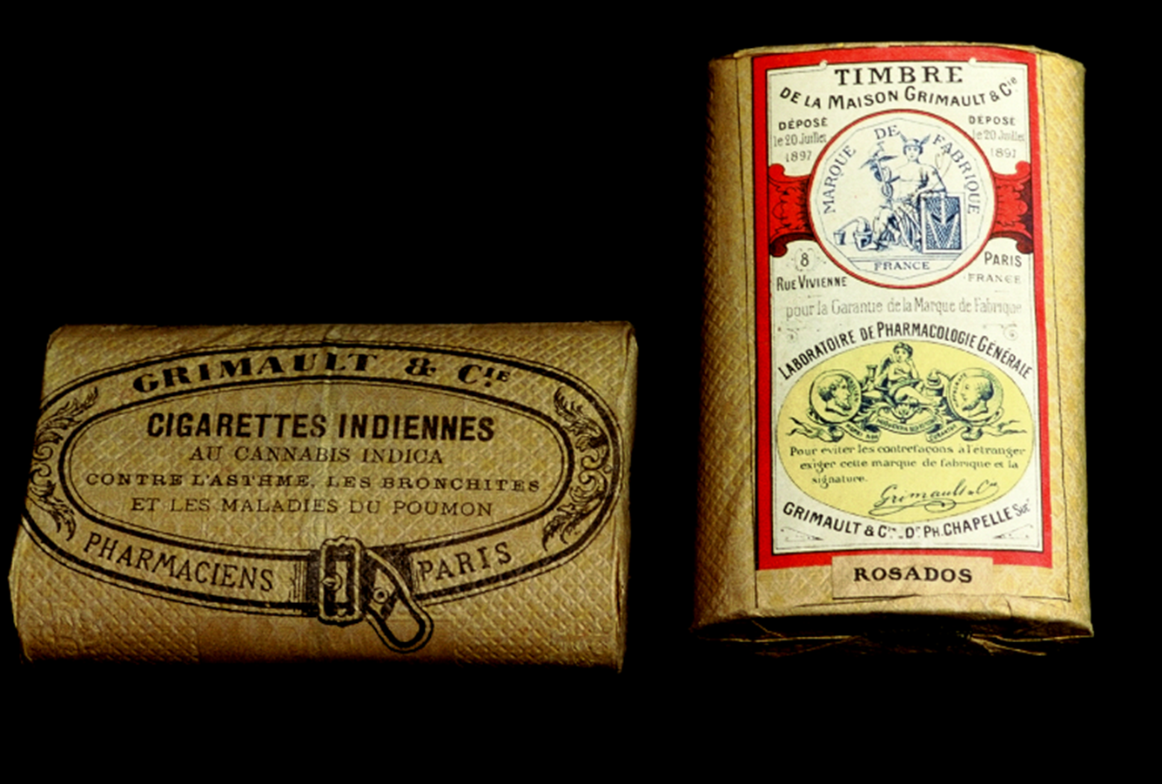

Slide 28
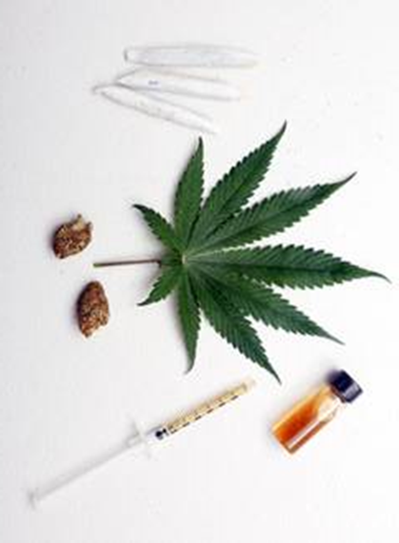
Medical Marijuana
Misnomer - the compounds with therapeutic benefit are cannabinoids.
Main active ingredients currently utilized for desired medicinal effects:
cannabidiol (CBD)
delta-9 tetra-hydro-cannabinol (THC)
Terpines – focus of studies
Buds and leaves of the plan:
Smoked, vaporized, extracted, concentrated, processed into edibles.
% of THC or CBD can be assessed and manipulated.
State laws limit what can be provided as “medical” product

Slide 29
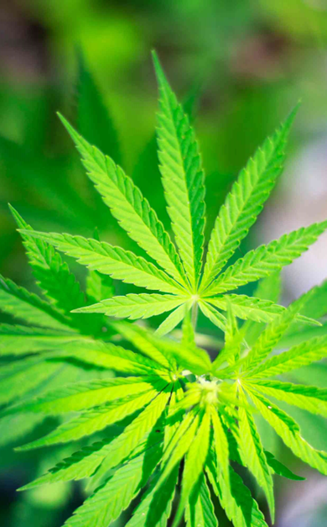
FDA Approved Medical Marijuana Products
Dronabinol (Marinol) –
Synthetic THC – oral capsule or solution
FDA approved as Schedule III
Indications: Cancer-induced N and V; anorexia/cachexia associated with AIDS (not in children)
Nabilone (Cesamet) –
Synthetic THC – oral capsule
FDA approved as Schedule II
Cancer-induced N and V in adults
Not recommended in children because of psychoactive effects and lack of safety data

Slide 30
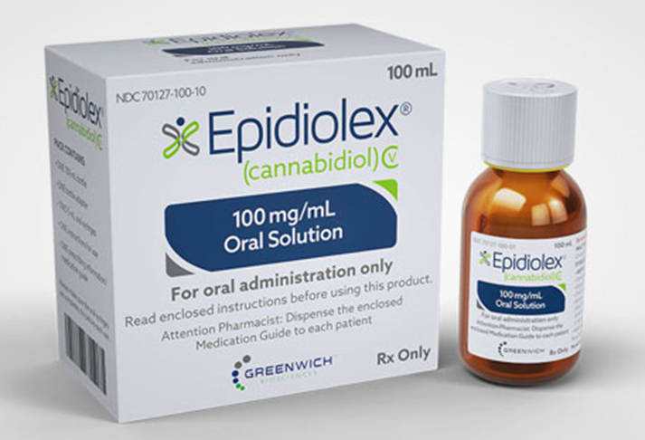
FDA Approved Medical Marijuana Products
CBD (Epidiolex)
CBD, plant derived – oral solution
FDA approved – child epilepsy
Dravet and Lennox-Gastaut syndromes
Nabiximols (Sativex) – nasal spray
Ratio of THC:CBD 2.7:2.5, plant derived
FDA approval in Phase 3 trials
Neuropathic pain, cancer pain, MS spasticity
Available in Europe

Slide 31
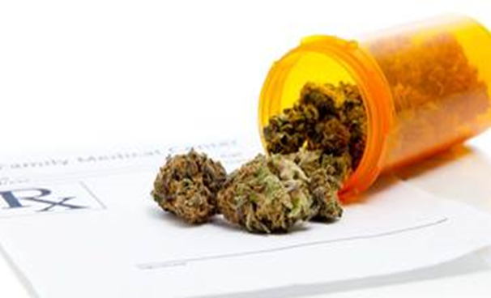
“Medical Marijuana” Products Available
No FDA approval – Schedule 1 controlled substance
Generally Cannabis extracts/concentrates
Varying concentrations of plant-derived THC and CBD
Concentrates can be highly potent – 39%- 80% THC
Many edible products – content unclear
A limited number of state laws allow smoked cannabis
~20% THC
Very limited data on safety of long-term use of CBD for medicinal purposes
No requirements for purity, standardization of content, assurance of safety from contaminants – food not drug

Slide 32
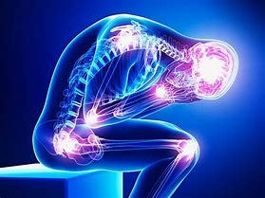
Chronic and Neuropathic Pain
Substantial evidence of moderate effect
2015 review by Whiting et. al
All included studies examined only cannabis or its extracts!
Notes:
--Substantial evidence of moderate effect
--2015 review:
--RCTs of cannabinoids v. placebo, usual care, or no treatment

Slide 33
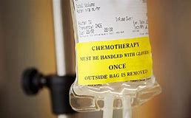
Chemotherapy Induced Nausea and Vomiting
Conclusive evidence that oral THC and CBD are effective
But…No more effective than the usual
When, then?
Notes:
--as effective as conventional first-line anti-emetics
--Perhaps as an adjunct or when first line options fail

Slide 34
Pathologic Weight Loss
Limited evidence in people with AIDS to:
increase appetite
decrease weight loss
Insufficient evidence in:
cancer related anorexia-cachexia
and anorexia nervosa

Slide 35
Anxiety
Limited evidence for CBD
Major Caution:
Moderate Evidence that cannabis can make some forms worse
Notes:
--for social anxiety disorders
--Moderate evidence for daily cannabis use INCREASING anxiety symptoms and heavy use being associated with social phobia disorder

Slide 36
The jury is out on…
Epilepsy
Childhood intractable epilepsies?
Addiction
PTSD
Tourette Syndrome
Autism Spectrum Disorders
Notes:
Epilepsy: need more human data, but THC and CBD appear to prevent sz in animal models
--Intractable childhood epilepsy is a special case: unblended trials with CBD showed improvement
Addiction: no evidence of benefit
--BUT! We do not have high quality evidence in OUD
PTSD: not much data but what we do have showed no effect
TS
ASD

Slide 37
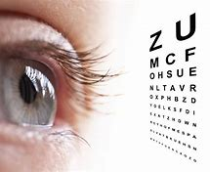
Doesn’t seem to help…
Glaucoma
Depression associated with chronic pain or MS
May INCREASE risk of MDD
News.Berkeley.edu
Notes:
Glaucoma: limited evidence of no effect
--single randomized crossover study with THC and CBD preparations

Slide 38
Possible Adverse effects
Impaired concentration
Delayed reaction time when performing tasks
Case series of three teens with chronic debilitating non-specific pain with no specific identified etiology
One with no response; other two with no improvement - one with impaired concentration, one with daily “highs”
Dizziness, anxiety, sedation, fatigue, decreased reflexes, confusion, and motivation, decreased concentration, intoxication
Important to recognize that teen may not see that their functioning may not be improved with medical marijuana and may be worsened.
Addiction risk may be higher; beware of self-medication
+ Harrison, Bruce, Weiss. Mayo Clin Proc 2013;88(7):647-650.

Slide 39
Risks
Need to balance potential benefits with known and unknown risks
THC –
Drowsiness and dizziness, irritability, coordination, memory/learning
Side effects of recreational marijuana can inform potential effects of medicinal marijuana
CBD
Somnolence, diarrhea, decreased appetite – 75%
Adults – dizziness, somnolence, dry mouth, muscle spasm, pain
Modulates hepatic cytochrome 450 enzymes → drug interactions
Long-term risks of CBD unknown
Dronabinol – restlessness, drowsiness and dizziness
Limited information overall.

Slide 40
Additional Risks of medicinal products
Concern about contaminants
Heavy metals, insecticides, pesticides, solvents from production,
Quality
% of what is advertised vs. what is present
Composition
Amounts of THC, vs. CBD vs. other “natural cannabinoids”

Slide 41
Lack of Standardization: Implications for consumers
Study from Netherlands*
Reviewed 46 cannabis oil samples provided by consumers and dispensaries
Analyzed for content of stated THC and CBD
Found many differed from claimed content on label
Several with NO or lower amount of advertised THC or CBD; 57% had THC >1% (one 57.5%); were mislabeled with what was present in product
Study looking at contaminants of both home and commercially prepared samples of medicinal products**
Significant number still contained solvent advertised as eliminated
Naptha, ethanol, petroleum ether, olive oil
Also with insecticides, heavy metals, pesticides
Important terpenes absent in many
+ Hazenkamp, On-line Autumn 2011:17-18; https://pdfs.semantic-scholar,org; **Romano LL. Int Assoc for Cannabinoid Medicines 2013; 1(1):1-11.

Slide 42
Pennsylvania Medical Marijuana Law: 2017
Regulated through:
Training and registry of providers who can “recommend” use
Registry of Providers of products – growers, processors,
dispensaries
Limitations of access for children <18 years
Close monitoring of production, supply, sale: “seed to sale”
Originally product only CBD oil, cannabis extracts/oils; edibles,
Recent amendments – “leaf product able to be smoked”
Nationwide, fears about increased rates of use with legalization have not materialized – exception – initiation by young adults

Slide 43
Pennsylvania - Qualifying Conditions: “serious medical conditions” - 23 listed
Inflammatory bowel disease
Intractable seizures
Multiple sclerosis
Neurogenerative diseases
Neuropathies
Opioid use disorder – where convention therapies are ineffective
Parkinson’s disease
PTSD
Severe chronic or intractable pain
Sickle Cell anemia
Terminal Illness
Tourette Syndrome
ALS
Anxiety Disorder
Autism
Cancer
Crohn’s disease
Damage to nervous tissue of CNS, with spasticity and neuropathies
Dyskinetic and spastic movement disorders
Epilepsy
Glaucoma
HIV/AIDS
Huntington’s disease

Slide 44
Why are we seeing increasing acceptance of marijuana use?
Assumption that if it is OK for adults, it is OK for children and teens
There are no good public health messages that make marijuana “not cool” to use
Overwhelming support from “big marijuana” industry
Major effect on legislators at state level
Population sees only financial benefit from taxation
Billion dollar revenues from sales tax, licenses
No quantification of costs to medical system, individuals
>60 % of American public supports national level legalization of marijuana

Slide 45
Continuing Challenges:
Getting the message out that marijuana is NOT for our pediatric population!
Making marijuana smoking as undesirable as cigarette smoking
Enforcing “underage recreational marijuana use” for <21 year olds
Avoiding similar marketing experience of “big tobacco”
Counseling parents about their own legal or medical use
Supporting the need for research on adverse effects as well as efficacy of medical marijuana

Slide 46
Take-Away Messages
There is accumulating scientific data about the adverse effects of marjuana use for both the developing fetus, and adolescents -specifically related to brain development, behavior and mental health disorders
Despite this, there are high rates of use among adolescents and young adults and the perception that marijuana use is harmful is at an “all-time low”.
The U.S. states with legalized recreational use have higher rates of use by teens and young adults
The challenge of the pediatrician is to counter arguments that marijuana is benign and that the benefits of legalization outweigh the risks to society

Slide 47
Questions?

Slide 48
REFERENCES:
El Sohly MA, Mehmedic Z, Foster S, Gon C, Chandra S, Church JC. Changes in cannabis potency over the last 2 decades (1995–2014): analysis of current data in the United States. Biol Psychiatry. 2016;79(7):613–619.
National Academies of Sciences, Engineering, and MedicineHealth and Medicine DivisionBoard on Population Health and Public Health Practice Committee on the Health Effects of Marijuana. The Health Effects of Cannabis and Cannabinoids: The Current State of Evidence and Recommendations for Research. Washington, DC: National Academies Press; 2017.
Elliott J, DeJean D, Clifford T, et al. Cannabis-based products for pediatric epilepsy: a systematic review. Epilepsia. 2019;60(1):6–19,\.
Gunn JK, Rosales CB, Center KE, et al. Prenatal exposure to cannabis and maternal and child health outcomes: a systematic review and meta-analysis. BMJ Open. 2016;6(4):e009986.
Conner SN, Bedell V, Lipsey K, Macones GA, Cahill AG, Tuuli MG. Maternal marijuana use and adverse neonatal outcomes: a systematic review and meta-analysis. Obstet Gynecol. 2016;128(4):713–723.
Ammerman S, Ryan SA, Levy S, Siqueira LM, Tau G, Gonzalez PK, Smith VC. American Academy of Pediatrics, Committee on Substance Abuse and Committee on Adolescence. Technical Report: The Impact Marijuana Policies on Youth: Clinical, Research, and Legal Update. Pediatrics. 2015; 135(3): January 26, 2015.

Slide 49
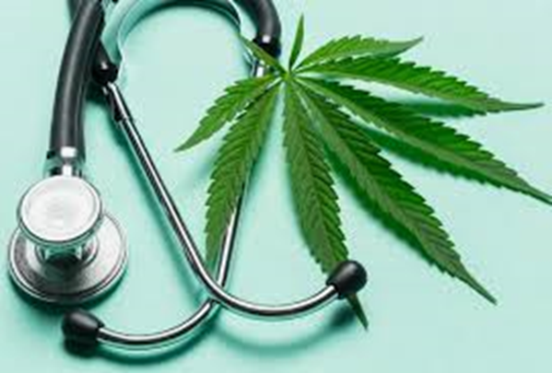
What to we know about Effectiveness in adults?
Strong Evidence
Chemo-induced nausea and vomiting – THC and CBD
Spasticity from MS - Oral cannabinoids and nabiximols; THC
and THC/CBD combined
Chronic neuropathic pain – THC/CBD, inhaled MJ
Moderate Evidence
Tourettes – THC; OSA, fibromyalgia, chronic pain – THC, THC/CBD
Insufficient evidence
PTSD – nabilone in one study; no effect with cannabis
Parkinson’s, schizophrenia, anxiety, cancer, addiction, IBS, glaucoma
*Source: National Academy of Sciences; 2017 – “The health effects of cannabis and cannabinoids”

Slide 50
How about children and teens?
Evidence strongest for:
Chemotherapy-induced nausea and vomiting
Dronabinol, Nabilone and THC
Side effects of drowsiness and dizziness common
Seizure disorders: Dravet and Lennox-Gastaut syndromes
CBD formulations - Epidiolex
Limited evidence:
spasticity from neurological conditions – Dronabinol
Neuropathic pain with major depression,(dronabinol) PTSD and sleep disorder (CBD), Tourette (THC)
Insufficient/No evidence for:
Spasticity, neuropathic pain, PTSD, Tourette syndrome, Autism

Slide 51
1979-1980 Drug Use Peaked!
Slide from W Milchak, LCSW
Notes:
Seems the 60s alcohol/drug wave crested in 1979
Been a steady downward trend with a few slight increases
Just say no and Partnership for a Drug Free America

Slide 52
Perceived Great Risk from Substance Use among Youths Aged 12 to 17: 2015-2019
Substance Use | 2015 | 2016 | 2017 | 2018 | 2019
Smoking Marijuana Once or Twice a Week | 40.6⁺ | 40.0⁺ | 37.7⁺ | 34.9 | 34.6
Using Cocaine Once or Twice a Week | 80.2⁺ | 80.6⁺ | 80.1⁺ | 79.6 | 78.7
Using Heroin Once or Twice a Week | 82.9 | 83.4⁺ | 84.0⁺ | 83.0 | 82.1
Having 4 or 5 Drinks of Alcohol Nearly Every Day | 64.1 | 65.5⁺ | 65.2⁺ | 64.4 | 63.5
Smoking One or More Packs of Cigarettes per Day | 68.2⁺ | 69.3⁺ | 67.2⁺ | 65.3 | 65.0
+ Difference between this estimate and 2019 estimate is statistically significant at the .05level

Slide 53
Neuroimaging studies with adolescents
fMRI Studies
Differences in levels of activation of hippocampus (memory) compared with controls*
Functional connectivity studies of frontoparietal areas of brain - disrupted neuro-circuitry during task demands**
Inhibitory processing studies - marijuana users had exaggerated responses to both inhibitory and non-inhibitory trials – in prefrontal and parietal regions***
DTI (diffusion tensor imaging) studies
no effects on white matter integrity
Overall – evidence of altered neural response patterns in marijuana using teens that is consistent with neurocognitive studies.
Evidence is evolving
*Jacobsen, 2004;**Jacobsen, 2009; ***Tappert, 2007

Slide 54
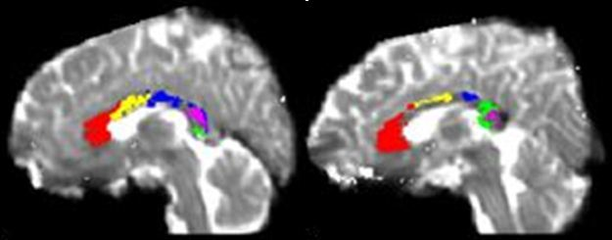
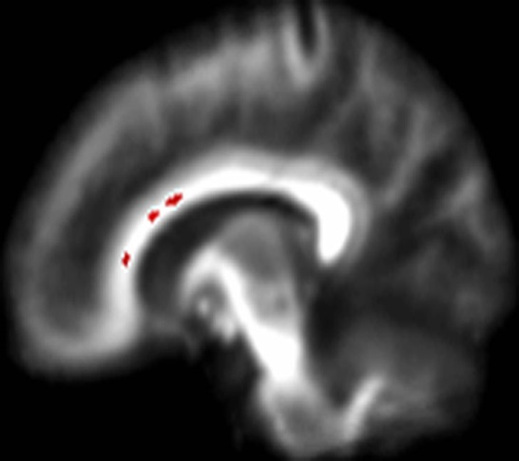
Diffusion Tensor Imaging Studies;
Poorer communication across different parts of the brain
Healthy non user
Daily MJ user
Schizophrenic patient
Source: Arnone D, Barrick TR, Chengappa S et al. Corpus callosum damage in heavy marijuana use: Preliminary evidence from diffusion tensor tractography and tract-based spatial statistics. NeuroImage, 2008; 41:1067-1074
Notes:
This slide shows the results of one such study. These are MRI scans of the corpus callosum, the bundle of fibers connecting the two brain hemispheres, allowing the two hemispheres to communicate and work in a coordinated way. Young adult males who smoked marijuana daily (and started at an average age of 15 yrs) were scanned along with age-matched non-users. All had low levels of alcohol use.
The different regions of the corpus callosum fibers are shown in bright colors on these two scans. The circled area on the scan of the daily user (right) shows thinner corpus callosum fibers than the scan of the non-user (left), indicating that there are white matter integrity issues for the daily user.
Poorer communication across different parts of the brain that need to work together for proper cognitive function may be one cause of cognitive disorders such as schizophrenia.

