Slide 1
impacts of covid pandemic on developmental-behavioral care of children
May 26, 2021
Kate Wallis, MD, MPH
Sandhyaa Iyengar, MD, MPH
| Developmental-Behavioral Pediatrics

Slide 2
Disclosures
We have no financial disclosures.

Slide 3
Objectives
Understand the importance of developmental surveillance, screening and early diagnosis, including autism spectrum disorder, especially in the setting of pandemic-related disruptions in care.
Recognize the ways that the COVID-19 pandemic has affected the detection of developmental delays and autism spectrum disorder, as well as receipt of interventions critical for optimal early childhood development.
Identify ways to address the post-pandemic well-being for children with developmental issues.

Slide 4
Impact on Developmental screening in primary care
Impact on diagnosis of developmental disabilities
How do we evaluate the impact on emotional-behavioral health?
Adapting with Early Intervention and remote learning

Slide 5
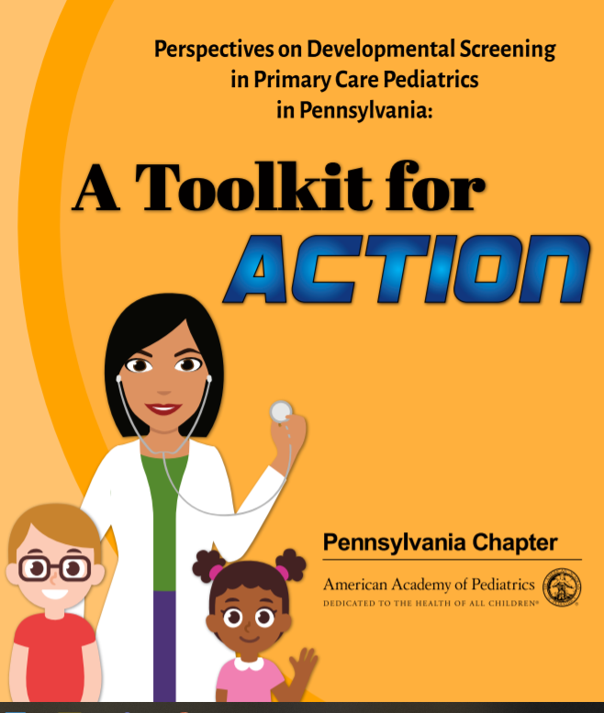
PA Chapter of the AAP. Perspectives on Developmental Screening in Primary Care Pediatrics in Pennsylvania: A Toolkit for Action.
Notes:
We’re going to begin tonight by talking about developmental surveillance and screening—the opportunities that pediatricians have to help identify children with developmental risk early. I’d like to highlight a toolkit that we developed with support from the PA AAP Chapter and the AAP Section of Developmental and Behavioral Pediatrics. We started this work by collecting stories and information about current practices from pediatricians in PA, so if you responded to our survey (Pre-COVID), your voice may be represented. That work also highlighted that there were large gaps in knowledge about guidelines for developmental and autism screening. Unfortunately, the toolkit was finalized just before the pandemic struck, so this is our opportunity to share that work with you!

Slide 6
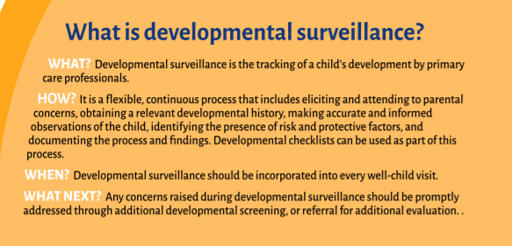
Developmental surveillance as a first step
PA Chapter of the AAP. Perspectives on Developmental Screening in Primary Care Pediatrics in Pennsylvania: A Toolkit for Action.
Notes:
Pediatricians are in an excellent position to complete developmental surveillance because of the continuity you have with your patients. This consists of asking parents about their concerns for a child, asking about milestones achieved, identifying risk and protective factors for developmental delay, and making observations about a child’s skills. This process is continuous and should be documented. When a child is not making expected progress, that should trigger additional steps including conducting more rigorous screening, or referring a child for early intervention services and for additional evaluation.

Slide 7
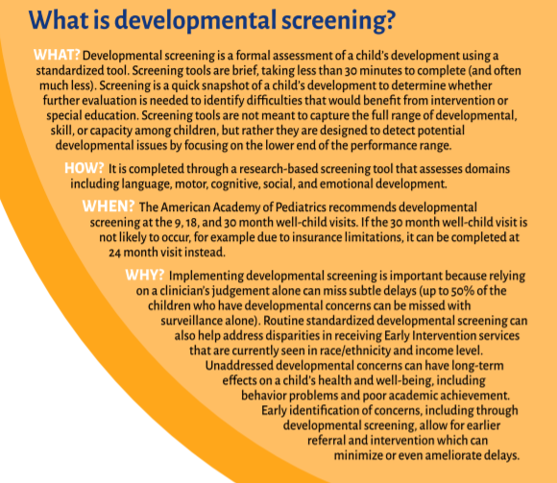
Developmental screening
9 months
18 months
30 months
PA Chapter of the AAP. Perspectives on Developmental Screening in Primary Care Pediatrics in Pennsylvania: A Toolkit for Action.
Notes:
Developmental screening is a more formalized process that requires use of a standardized screening tool. AAP Guidelines recommend developmental screening at 9, 18, and 30 months. There are many screening tools that assess a child’s skills in each developmental domains. The goal is to detect delays early and refer children to services.

Slide 8
Identification, evaluation and management of asd
AAP Guidelines for ASD Care:
Systematic routine surveillance in pediatric primary care
Screening at 18 and 24 months, or whenever concerns arise
Referral for evaluation and intervention services if concerns arise or screen is positive
“Treatments should be individualized, developmentally appropriate, and intensive”
Intervention includes:
  Behavioral interventions, such as Applied Behavioral Analysis (ABA)
  Educational support
  Developmental therapies (e.g., occupational therapy and speech/language therapy)
Hyman, S. L., et al. (2019). "Identification, Evaluation, and Management of Children With Autism Spectrum Disorder." Pediatrics: e20193447
Notes:
So to orient us, that was a brief overview of surveillance and screening for general developmental delays. An additional step is to think specifically about risk factors for autism spectrum disorder.
To try to improve the process and age of diagnosis, clear guidelines exist.
If a child is identified as having developmental concerns through surveillance or screening, or if there are additional risk factors for autism (such as having a sibling with autism), a child can complete standardized ASD Screening, which is also recommended universally for all children at 18 and 24 months.

Slide 9
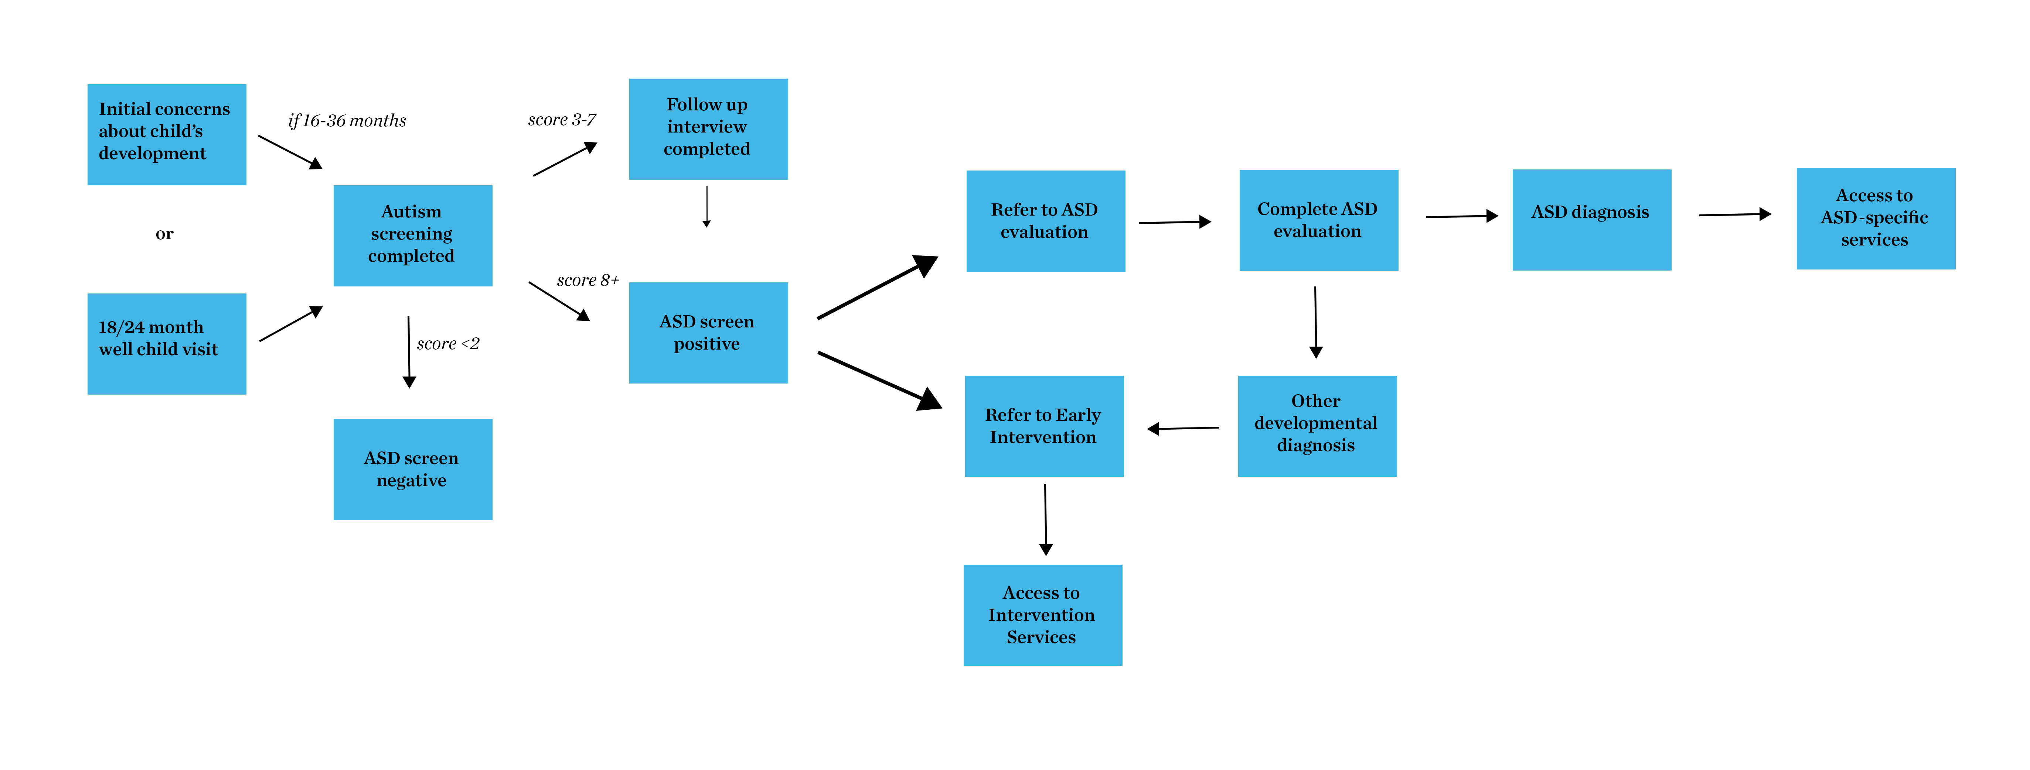
Autism Diagnostic Process
Wallis, K.E., The Roadmap to Early and Equitable Autism Identification (To Appear in Pediatrics).
Notes:
Here, I show an overview of the steps of how a child makes it through the process of noting initial developmental concerns to obtaining a diagnosis of ASD, and getting ASD-specific services (including behavioral therapy).

Slide 10
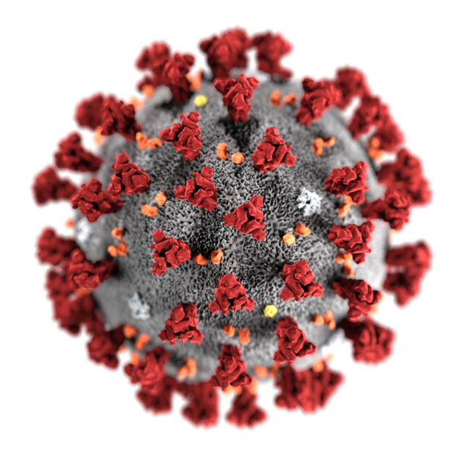
Autism Diagnostic Process
Wallis, K.E., The Roadmap to Early and Equitable Autism Identification (To Appear in Pediatrics).
Notes:
So this is clearly a complicated process. And then, of course, COVID struck. In the remainder of this talk, we’ll talk about the impact of the pandemic on each step of this process, and what this means for children, families, and for you as pediatricians.

Slide 11

Autism screening at chop
91% of children screened at least once
Guthrie, W., Wallis, K.E., Bennett, A. et al. (2019). "Accuracy of Autism Screening in a Large Pediatric Network." Pediatrics 144(4)
Notes:
CHOP uses the M-CHAT-F, which is available to families to complete electronically, either on a tablet in the waiting room, or through the digital portal.
In 2019, we examined screening across the 31 sites that comprise the CHOP Care Network (prior to the pandemic). 91% of all children seen for care were screened at least once.

Slide 12
CHOP Screening during covid
Wallis, et al. Rates of Screening for Autism Spectrum Disorder during the COVID-19 Pandemic in a Large Primary Care Network. (Pending review)
Notes:
So we had the opportunity to examine screening rates again during the pandemic. We feared that screening numbers and completion rates would be much lower—because of the dip we know that occurred in seeking well child care, and in concerns about use of shared tablets in the waiting room that was stopped.
Overall, the number of well child visits for children ages 16-26 months (screening ages) dipped nearly 7% between 2019 and 2020.
Here, we see monthly numbers of completed screens among children who presented for care.
Unsurprisingly, the number and percentage of children screened in March, April, May and June dipped. But screening rates nearly rebounded to pre-pandemic levels. 90% of children were screened in 2019 and 86% were screened in 2020.
This amounted to 2000 fewer M-CHATs administered, which means 2000 fewer opportunities to identify risk. 2000 fewer opportunities to engage families in discussions of developmental concerns. .

Slide 13
Pediatricians can. . .
Remain vigilant of developmental risks.
Consider catch-up screening when children present for care.
Notes:
. So while this certainly isn’t as negative a picture as we might have feared, we still need to be cognizant that some children may have missed screening opportunities. When children present again for care, pediatricians can consider screening them, even if outside of the typical screening window. The M-CHAT is validated for children up to 30 months, and other tools are validated up to 36 months or beyond.

Slide 14
Impact on diagnosis of developmental disabilities
Impact on developmental screening in primary care
How do we evaluate the impact on emotional-behavioral health?
Adapting with Early Intervention and remote learning

Slide 15


Shutdowns
Notes:
So as we all experienced last March, very quickly non-urgent care in-person was discouraged by our institutions. As clinicians, we all worried about what this would mean for our already lengthy waiting lists, if we weren’t able to provide assessments or ongoing care to patients. Another concern was about the validity of our assessments, given the unknown impact of personal protective equipment on the children we are observing for developmental and behavioral concerns. For example, some of the assessments we traditionally conduct were deemed not valid or standardized if administered with face masks or other PPE.

Slide 16

Transition to telehealth
Notes:
Very quickly, many subspecialists who evaluate children for DD, ASD transitioned to telehealth care. For example, in a survey we conducted, 100% of DBP practices with an associated fellowship program moved to video-based telehealth in March of 2020.

Slide 17
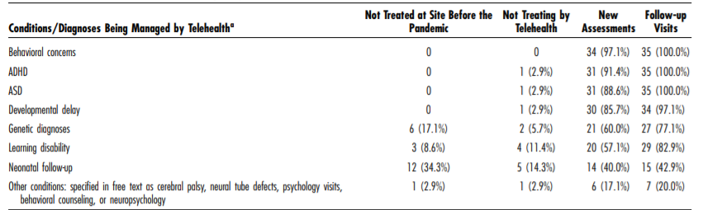
Telehealth
Wallis, K. E., et al. (2021). "Use of Telehealth in Fellowship-Affiliated Developmental Behavioral Pediatric Practices During the COVID-19 Pandemic." J Dev Behav Pediatr 42(4): 314-321.
Notes:
Here we see that most of these programs were conducting new assessments for the most common issues that we see in DBP, including:

Slide 18
Provider experiences with telehealth assessments
“I can get a lot of observations about how they're doing in their home environment, what kinds of things they gravitate towards, and [how they] like to spend their time. So I enjoy that observation piece, because I think I get a lot of data when they're comfortable like that.”
“In the setting of the pandemic, I prefer to [provide] feedback over video because I think so much of this is relationship building. And it's very hard to do that with a mask.”
“I found that all different types of families benefited because we were able to do their child's evaluation and work on getting them services and helping them understand their child and what supports they need.”
Wallis, K.E., Kellom, K., Ortiz, P. et al. (Review pending)
Notes:
So what has telehealth in DBP practice been like for providers and families? We are in the midst of a mixed methods study to find out. Here, I present some illustrative quotes from providers about the benefits they are seeing with telehealth, specifically for DBP care.

Slide 19
Provider experiences with telehealth assessments
“One of the challenges going into telemedicine was that parents – or this is just the feeling—was that parents might not feel like the assessment is valid because it’s done on video and not in person.”
“I think definitely access to telehealth is more limited for families with limited English proficiency, just because of the amount of bureaucracy. Just getting the app, signing this consent form, signing that consent form.”
Wallis, K.E., Kellom, K., Ortiz, P. et al. (Review pending)
Notes:
Here I present some of the challenges that have been reported.
But overall, with some tweaks, it seems that all participants in our study so far would like to continue to use telehealth in DBP in the future. So our job is the figure out its best uses and how to make it work for everyone who wants it.

Slide 20
Pediatricians can. . .
Use telehealth to observe a child in his or her home environment to perform developmental surveillance.
Identify challenges, but also sources of strength and resilience within the home.

Slide 21
How do we evalute the impact on emotional-behavioral health?
Impact on developmental screening in primary care
Impact on diagnosis of developmental disabilities
Adapting with Early Intervention and remote learning
Notes:
Good evening everyone, my name is Sandhyaa Iyengar and I am so glad you all could join for this evening’s discussion. Let’s talk first about how we can evaluate the impact of COVID on emotional and behavioral health.

Slide 22

This happened in our lifetime
“I felt like my world was turned upside down.”
Empty grocery shelves
Job loss
Panic, anxiety, sense of vulnerability
Compounded by political instability and national reckoning with racism
Illness – 167 million
Death – 3.46 million
Movies, restaurants, stores closed -> new curbside culture
Economic instability - recession?
Notes:
It’s common to feel numb after hearing about the pandemic over and over, but I find it helpful to jolt our memory to just how shocking the experience was, for all of us. *The mom of one of my patients described it as the world turned upside down, which maybe some of you can relate to. *To me, of this list, most notable was the widespread panic - I remember wearing a turtleneck sweater pulled up above my nose, in the time before we readily had access to masks, and going to the grocery to find near empty shelves, and I remember one lady ahead of me was checking out four carts of canned soup, and that’s when I got scared.

Slide 23
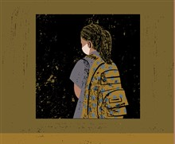
Through the eyes of children
Social distancing rules
Loss of family job/income
Family illness/death
Loss of peer interactions
Altered holiday celebrations
Closed playgrounds and parks
Change to routines
Virtual learning
Loss of school lunch
IEP/504 supports?
Virtual extended family
Masks everywhere
And wearing a mask…
Notes:
Now viewing all this chaos through the eyes of children. *They are at significant developmental risk due to disruptions to their proximal contexts and daily lives – small and big - including the concept of social distancing impacting peer interactions and relationships with extended family, events like birthdays, graduations and holidays all different than expected. Family illness, in fact researchers estimate 40,000 children in the U.S. have lost a parent to COVID-19, a tragedy disproportionately impacting Black children. Also adjusting to new routines and masks. Grappling with virtual learning and school encroaching on the home environment.

Slide 24
Meet tyrell
Tyrell was seen by DBP in November 2019 at 24 months old, had mild delays in language and play skills, and was referred for Early Intervention and follow-up in 6 months.
Returns to DBP Apr 2021 at 3.5 years old with severe delays & no services.
Started EI Jan 2020, put on hold Mar 2020, and when EI reached out to mom Jun 2020 she declined video therapy.
Aug 2020 agreed to video but held again when Tyrell’s mother and grandparents got COVID. Grandfather died shortly afterwards.
Mother couldn’t keep part-time jobs and stays home with Tyrell, and is experiencing significant anxiety. There are two older brothers doing online schooling, and it is cramped in the one-bedroom apartment where they live.
No exposure to other children because unsafe neighborhood.
Never completed transition from EI to Intermediate Unit.
Notes:
In the context of all these changes, I’d like to talk about a case. Tyrell was seen in developmental-behavioral pediatrics in November 2019 when he was 24 months old, noted to have mild delays in expressive and receptive language and his play skills. We recommended Early Intervention services with close follow-up in 6 months. He returns a year and half later with severe developmental delays across domains, as well as regression in self-care like using a spoon and functional words to communicate. After the initial appointment, mom pursued EI right away and did a great job starting speech therapy and specialized instruction for a little over 2 months until pandemic hit and services stopped March 2020– and mom declined the switch to video therapy because she was an essential worker at a grocery, and grandmother wouldn’t be able to manage video visits. Then the family got sick and grandfather died from COVID. Tyrell’s mom has difficulty maintaining employment and has her own mental health challenges. They live in a cramped one-bedroom apartment with 2 siblings and grandmother, so the lockdown was a very hard period for the family, and being outside was not a safe environment. At age 3 Tyrell did not transition to Intermediate Unit and is not getting any services.

Slide 25



Evaluating COVID’s impact on emotional/behavioral health
Social determinants of health including
Food insecurity
Stable housing
Employment
Internet connectivity
Pediatrician screening of social determinants of health has now taken additional urgency, especially for historically under-resourced communities and minoritized populations facing inequities
https://www.feedingamerica.org/sites/default/files/2021-03/Local%20Projections%20Brief_3.31.2021.pdf
Notes:
There are a few important factors to consider when evaluating the full extent of the impact of COVID on children’s emotional and behavioral health, many of these highlighted in Tyrell’s case.
First, pediatricians assessing the social determinants of health takes on an added urgency as the pandemic has resulted in significant economic impacts on families. These impacts are especially true for historically under-resourced communities and populations facing inequities. Food insecurity projections for 2021 are concerning, including 17% of children in Pennsylvania and 5% with very low food insecurity. It is even more shocking in other states, such as California and Texas which have 1.4 and 1.7 million children living with food insecurity, and both states had a rise of over 700,000 children since prior to the pandemic. Within weeks, tens of millions of people lost jobs or saw declines in hours worked. Official unemployment rate rose to 14.7% in April 2020, the highest rate since 1948 when data started to be collected. Stable housing has been a challenge for many families, despite moratoriums on evictions in some places. Additional pandemic stressors include those related to multigenerational living and employment as an essential worker and finding childcare. Internet connectivity has become necessary for socialization, remote learning, employment, and access to health care and must also be included in the evaluation of social determinants of health.

Slide 26

Evaluating COVID’s impact on emotional/behavioral health
Parent/caregiver well-being
Parents with their own mental health problems, health issues, or substance use have more difficulty responding to children’s stress
Parents of children with disabilities have reported even greater levels of stress, mental health symptoms, burnout, and social isolation during COVID
Pediatricians can screen for parental well-being, including perinatal depression and intimate partner violence, and provide support by offering empathy and recommending self-care/mindfulness and referral resources
Murphy, A., Pinkerton, L. M., Bruckner, E., & Risser, H. J. (2021). The Impact of the Novel Coronavirus Disease 2019 on Therapy Service Delivery for Children with Disabilities. The Journal of pediatrics, 231, 168–177.e1. https://doi.org/10.1016/j.jpeds.2020.12.060
American Academy of Pediatrics. Interim Guidance on Supporting the Emotional and Behavioral Health Needs of Children, Adolescents, and Families During the COVID-19 Pandemic. https://services.aap.org/en/pages/2019-novel-coronavirus-covid-19-infections/clinical-guidance/interim-guidance-on-supporting-the-emotional-and-behavioral-health-needs-of-children-adolescents-and-families-during-the-covid-19-pandemic/
Notes:
Secondly, we should consider parent well-being. Increased stress associated with the pandemic may cause or exacerbate emotional vulnerabilities and distress in parents and other caregivers. Parents struggling with their own mental health problems, health issues, or substance use will have more difficulty responding sensitively and supportively to their children’s reactions to stress. Parents of children with disabilities have reported even greater levels of stress, mental health symptoms, burnout, and social isolation during COVID than parents of nondisabled children. Screening for parental well-being, including perinatal depression and intimate partner violence, can be combined with screening for social determinants of health and may facilitate conversations with and referrals to community resources. In Tyrell’s situation, asking open-ended questions about parental well-being led to disclosure of depression and referral to counseling services for grief.

Slide 27

Evaluating COVID’s impact on emotional/behavioral health
Children with special health care needs
Depend on uninterrupted access to specialized services
Interruption leads to stress on the family and increased risk for losing skills
Pharmacological treatments
Respite care
Note that many children with a disability experience dual risk due to additional social determinants of health
Pediatricians can inquire about services and support families, and advocate for them, to receive ongoing services
American Academy of Pediatrics. Interim Guidance on Supporting the Emotional and Behavioral Health Needs of Children, Adolescents, and Families During the COVID-19 Pandemic. https://services.aap.org/en/pages/2019-novel-coronavirus-covid-19-infections/clinical-guidance/interim-guidance-on-supporting-the-emotional-and-behavioral-health-needs-of-children-adolescents-and-families-during-the-covid-19-pandemic/
Notes:
We also need to consider the situation of children with special health care needs, who depend on uninterrupted access to specialized medical or mental health services. Interruption of services for these children can increase stress on the family and place the child at risk for losing skills. It is important for the pediatrician to inquire about continued access to these services, to support families experiencing an interruption of services, and to advocate for continued services. It is essential to ensure continuation of pharmacologic treatments and that parents have the financial and prescriptive access to ongoing medication management. I saw a patient with ADHD whose medication had not been refilled for months, and another child who was unable to make it to follow-up to titrate up anxiety medication dose and was therefore not optimized. Families of children with medical complexity may experience loss of respite services or nursing services, which is often an additional stressor. Note that many children with a disability experience dual risk due to additional social determinants of health.

Slide 28
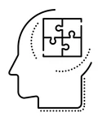

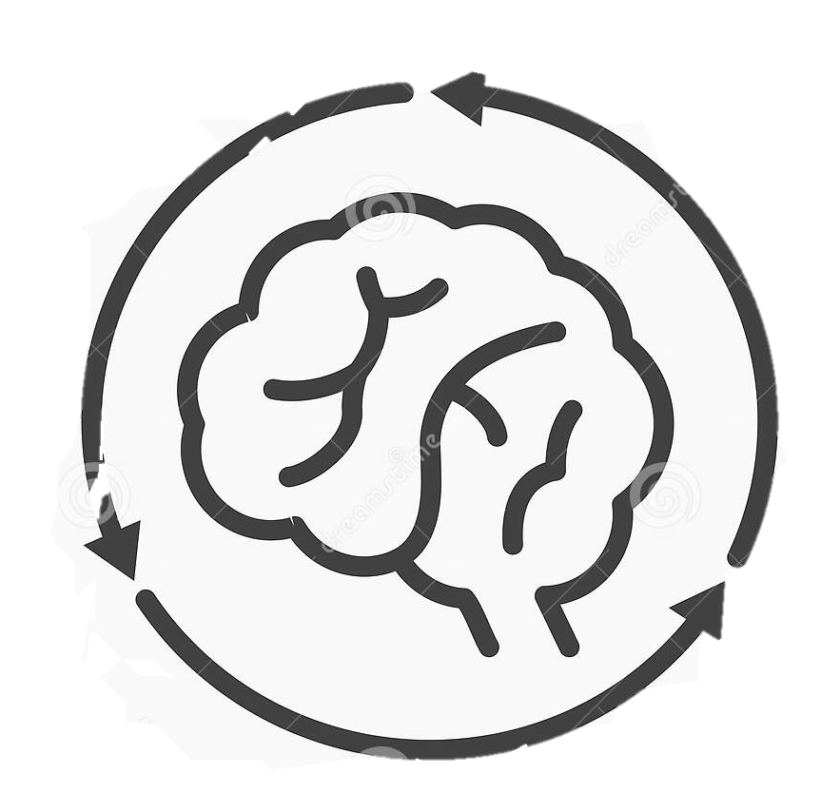
Considerations for autism spectrum disorder
Disruption in routines, therapies, and supports including ABA
Behavioral challenges
Modified social demands
Observational studies:
Decreased physical activity, increased screen time
No significant worsening in adaptive functioning, problematic, and repetitive behaviors after lockdown in Italy
After resumption of ABA, acquired skills were maintained but no significant improvement + increased ritualization and stereotypies in Italy
Baweja R, Brown SL, Edwards EM, Murray MJ. COVID-19 Pandemic and Impact on Patients with Autism Spectrum Disorder [published online ahead of print, 2021 Mar 10]. J Autism Dev Disord. 2021;1-10. doi:10.1007/s10803-021-04950-9
Manning J, Billian J, Matson J, Allen C, Soares N. Perceptions of Families of Individuals with Autism Spectrum Disorder during the COVID-19 Crisis [published online ahead of print, 2020 Oct 22]. J Autism Dev Disord. 2020;1-9. doi:10.1007/s10803-020-04760-5
Sergi L, Mingione E, Ricci MC, et al. Autism, Therapy and COVID-19. Pediatr Rep. 2021;13(1):35-44. Published 2021 Jan 5. doi:10.3390/pediatric13010005
Garcia JM, Lawrence S, Brazendale K, Leahy N, Fukuda D. Brief report: The impact of the COVID-19 pandemic on health behaviors in adolescents with Autism Spectrum Disorder. Disabil Health J. 2021;14(2):101021. doi:10.1016/j.dhjo.2020.101021
Siracusano M, Segatori E, Riccioni A, Emberti Gialloreti L, Curatolo P, Mazzone L. The Impact of COVID-19 on the Adaptive Functioning, Behavioral Problems, and Repetitive Behaviors of Italian Children with Autism Spectrum Disorder: An Observational Study. Children (Basel). 2021;8(2):96. Published 2021 Feb 2. doi:10.3390/children8020096
Notes:
Specifically for individuals with autism spectrum disorder, the disruption to routines during the pandemic is a major stressor, especially related to therapies and intensive applied behavior analysis programming. The pandemic exacerbated existing staffing shortages for ABA, leading to long wait times for evaluations or services. In my clinical practice I have seen a sharp spike in behavioral challenges like self-injurious behavior, aggression towards family members, frustration related to communication, difficulties with sleep, regression in skills like toileting and emotional regulation, and withdrawn self-directed behavior – behaviors that like stem from children trying to grapple with their new world and limited behavioral support available for families. For my patients with autism, what I noticed, also supported in the literature, is often a thriving in remote learning settings – academics can be a major strength, especially when learning is driven at one’s own pace. There can be a reduction in anxiety around social situations in the virtual format, but children have less exposure to practice the socialization skills.
A few observational studies have been published, one which shows a decrease in physical activity and increase in screen time in children with autism, one study that fortunately found no significant worsening in the adaptive functioning, problematic, and repetitive behaviors after a lockdown period, and one study found that after suspension and resumption of ABA treatment there was a spike in stereotyped behavior and rituals, and while acquired skills were maintained there was no significant improvement demonstrated.

Slide 29
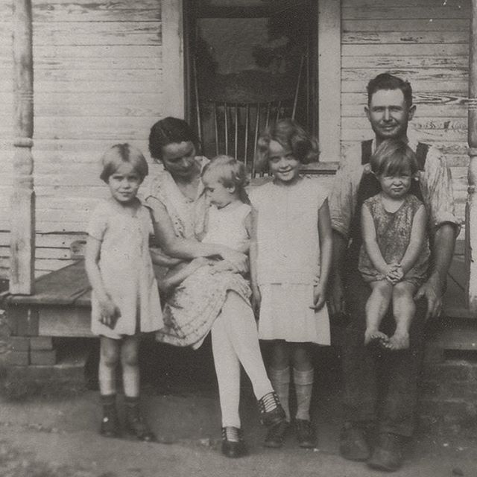

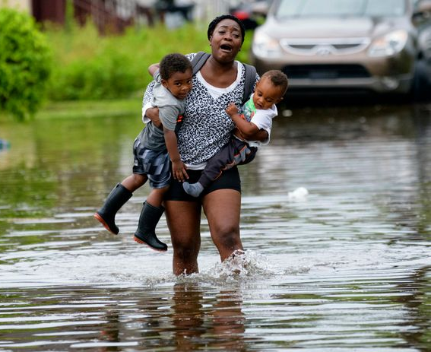
Lessons from history
Developmental stages are affected differently
Those who experienced Great Depression as young children were more adversely affected long term (lower confidence about the future, less optimal achievement, lower ultimate education attainment)
Young children <4 years old may especially be vulnerable to developmental shocks/insults from pandemic
Effects can be transient
After 9/11, greater substance use in adolescents who were affected directly; most effects in emotional well-being were mild and transitory
After Hurricane Katrina, declining PTSD & depressive symptoms 3 years later
Benner, A.D. and Mistry, R.S. (2020), Child Development During the COVID-19 Pandemic Through a Life Course Theory Lens. Child Dev Perspect, 14: 236-243. https://doi.org/10.1111/cdep.12387
Notes:
Another consideration comes from the history books – other large-scale sociohistorical events such as the 1918 influenza pandemic, the Great Depression, the 9/11 terrorist attacks, and the Great Recession of 2008 have jeopardized children’s health and disrupted their growth and development. One lesson is that developmental stages can be affected differently – such as those who experienced the Great Depression as young children, particularly boys, were affected more adversely in the long term. Early childhood is a period of rapid brain development and social growth, so this is a particularly sensitive and susceptible period of development when considering the impact of COVID.
On a hopeful note, after 9/11 - though young children who were affected directly by the terrorist attack – such as physically witnessing it or being injured – did have higher rates of substance use as adolescents – most effects related to emotional well-being were mild and transitory. This is consistent with findings of overall declining rates of PTSD and depressive symptoms 3 years later among young children directly affected by Hurricane Katrina.

Slide 30
Adapting with early intervention and remote learning
Impact on developmental screening in primary care
Impact on diagnosis of developmental disabilities
How do we evaluate the impact on emotional-behavioral health?
Notes:
Shifting gears to how developmental interventions adapted to COVID…

Slide 31
Meet jin
Jin is a 26 month old boy with global developmental delay. He made good progress initially with his Early Intervention services. Had timely transition to virtual format when pandemic started.
Mom doesn’t think virtual therapies have helped him at all. Jin will not attend to the screen.
Mom is working from home as a dispatcher for a car company and needs to take calls at any time. Mom tells the DBP that “it’s no use, I’m not a therapist, and he doesn’t know the people on the screen.”
Tried outpatient therapy but was told the waitlist is 8 months and her co-pays are high.
Notes:
Meet Jin, a 26 month old boy with global developmental delay. He did very well with Early Intervention services and switched seamlessly to virtual format with the pandemic. However, mom has no longer seen improvement and has difficulty getting Jin to participate. Mom works from home as a taxi dispatcher and has difficulty scheduling with Early Intervention and sometimes she needs to take calls unexpectedly. Mom says, “it’s no use, I’m not a therapist, and he doesn’t know the people on the screen.” Outpatient in-person therapy was not available to mom for long wait list and high costs.

Slide 32

Early Intervention
PA county EI services pivoted to virtual delivery model through Zoom in March 2020 and in-person services stopped
Eligibility evaluations paused and eligibility was based on screening tests
One study:
Limited parental satisfaction of EI services
30% of children who should have been receiving OT and 32% of children who should have been receiving ST were not receiving these services
https://www.eita-pa.org/
(resources for PA families
related to EI)
Murphy, A., Pinkerton, L. M., Bruckner, E., & Risser, H. J. (2021). The Impact of the Novel Coronavirus Disease 2019 on Therapy Service Delivery for Children with Disabilities. The Journal of pediatrics, 231, 168–177.e1. https://doi.org/10.1016/j.jpeds.2020.12.060
Notes:
Jin’s family struggles were a common theme this year. The goal of EI is to minimize the impact of a child's disability as early as possible to enhance future developmental outcomes while delivering services in the family's natural environment. Families were pivoted to a virtual delivery model during the pandemic, and anecdotally, experienced long wait times for eligibility and staffing. Often there was misinformation about what services were on hold and a significant portion of families who dropped out after perceiving limited benefit from virtual services. In a study of children across the nation in Early Intervention during the pandemic, only 40% of families were satisfied with services. Nearly one third of children who were supposed to be getting occupational therapy or speech therapy were not receiving those services.

Slide 33
Study about families in Early intervention
Families of children <3yo in Philadelphia surveyed on EI prior to and after city initiated pandemic mitigation strategies
Of those who initiated EI referrals, a similar % qualified for and received services pre- and post-pandemic
Guevara et al. CHOP Policy Lab.
Notes:
I wanted to take a moment to talk about an interesting study out of CHOP’s Policy Lab with Dr. Jim Gueverra which looked at families of children less than three years old in Philadelphia surveyed on EI before and after the start of the pandemic. They found that a similar percentage of families who initiated EI qualified and received services in both time periods.

Slide 34

Participants’ Perceptions
Satisfied with the length and pace of virtual EI visits
Service coordinators EI communicated updates well
Benefit of seeing providers’ faces especially if rapport pre-pandemic
Families appreciated the efforts made by EI to maintain services despite pandemic changes
Different perceptions in flexibility of scheduling
Communication gaps if just started EI or last-minute changes
Less effective due to increased distractions and decreased child participation
Child had not improved as much as with in-person visits and virtual evaluations were not as accurate
Conflicting time commitments and managing virtual meetings for their other children
Connectivity issues among parents and lack of appropriate therapeutic equipment
Notes:
Their study qualitatively looked at the participants’ perception of EI. Participants described that the length and pace of virtual visits was good, but some people thought that scheduling flexibility was limited. Though communication about the pandemic was generally good, a participant said quote I just stopped hearing from people, they did call and offer video visits but I never heard anything back after that end quote. Participants felt like virtual therapy sessions were less effective due to increased distractions and decreased child participation such as quote a 3 year-old is not gonna sit there and talk to the person, they’ll probably run around or play with other things end quote.
Overall families appreciated the efforts Early Intervention made to provide servicecs despite the pandemic, but there was often the perception that the child did not improve as much as with in-person visits. Some families talked about barriers, such as one saying quote sometimes I get caught up at work or with my other kids at appointments or something like that, so it’s kind of hard end quote. Another family talked about not being able to afford something that the child may need during therapy. Lastly, participants perceived that virtual evaluations were not as accurate as in-person evaluations.

Slide 35

Moving forward with EI
Families prefer an in-person or hybrid model of EI service delivery
The delivery model of in-person therapy and hands-on equipment has benefits for social interaction and parental perception of effectiveness
Anecdotally, families did benefit from parental coaching that virtual EI provides. This is consistent with the pre-pandemic EI model which emphasizes parent involvement.
Pediatricians can continue to empower parents as their child’s first teacher and refer to Early Intervention for evaluations so that services can address a child’s needs when most critical
Notes:
Moving forward, there appears to be a preference for in-person or hybrid model of service delivery – driven by the benefits of hands-on equipment and social interactions. However, pediatricians can play an important role in helping families continue to realize the benefits of early assessment and early intervention for a child’s development, including through a virtual model, especially as there are benefits from parent coaching that allow parents to take a very hands-on approach to therapy. Pediatricians can reiterate that this is consistent with the pre-pandemic model of EI that emphasizes parent involvement.

Slide 36
Meet hugo
Hugo is a second-grader with attention-deficit hyperactivity disorder who has been remote learning since the pandemic shut-down.
He works at the kitchen table with his three brothers and mom is on the couch doing her job from home. He says it is really distracting. There is homeroom 9-9:30am, independent assignments (which he doesn’t do), and about five 30 minute lessons for each subject.
Hugo says he “hates school” and he wants to play video games since he can’t really follow along with the teacher anyway. Most of the time the internet connection is choppy and the teacher doesn’t see when Hugo raises his hand.
He has an IEP and has accommodations when in-person including an aide, preferential seating, and prompts before directions – none available to him now.
Notes:
Another case – Hugo – who is a second grader with ADHD who is remote learning since the pandemic. He works at the kitchen table with his three brothers while mom works from couch – there are a lot of distractions. He has minimal instruction time and some independent assignments which he doesn’t typically complete. Hugo dislikes school, says he can’t really follow along with the teacher due to choppy internet or teacher not paying attention to him. He has an IEP and when in-person benefited from accommodations like an aide and preferential seating and prompts before directions, none available to him now.

Slide 37

remote learning challenges
Altered relationship with parents, peers, teachers
Logistics: quiet space, functioning devices, internet connectivity, multiple children learning on different schedules, securing childcare
Difficulty negotiating the educational system remotely
Loss of supports in IEP or 504 plan
Transitions between in-person/virtual learning harder for those with ADHD or ASD
School-based therapies low parental satisfaction (73%) compared to other settings
Pediatricians may serve as a source of information, evidence and reassurance where possible, especially for families who are reluctant to send their children back to school settings.
American Academy of Pediatrics. Interim Guidance on Supporting the Emotional and Behavioral Health Needs of Children, Adolescents, and Families During the COVID-19 Pandemic. https://services.aap.org/en/pages/2019-novel-coronavirus-covid-19-infections/clinical-guidance/interim-guidance-on-supporting-the-emotional-and-behavioral-health-needs-of-children-adolescents-and-families-during-the-covid-19-pandemic/
Murphy, A., Pinkerton, L. M., Bruckner, E., & Risser, H. J. (2021). The Impact of the Novel Coronavirus Disease 2019 on Therapy Service Delivery for Children with Disabilities. The Journal of pediatrics, 231, 168–177.e1. https://doi.org/10.1016/j.jpeds.2020.12.060
Benner, A.D. and Mistry, R.S. (2020), Child Development During the COVID-19 Pandemic Through a Life Course Theory Lens. Child Dev Perspect, 14: 236-243. https://doi.org/10.1111/cdep.12387
Notes:
So I saw Hugo at a time much later on the pandemic, when many school districts had already resumed in-person classes or hybrid. In many clinical encounters I saw stark disparities in which school districts had the resources to switch back to in-person. Virtual learning poses significant stressors for families – including a new parental role as a teacher or instructor, which can affect the parent-child relationship. That is especially true for the families I encountered where ADHD symptoms mandated frequent redirection and prompts from parent to stay on task. Students also had to navigate peer relationships in this new format, severely limiting their access to social. Teachers also may not have the opportunity to learn about a student as well in virtual format. Additional logistical challenges may include finding quiet space, functioning devices, and internet connectivity often for multiple children who are trying to learn on different schedules. There are many households in which caregivers may not have the ability to stay home to support their child’s remote learning needs, adding stress around finding childcare. Families whose primary language is not English may have difficulty negotiating the educational system remotely and may need extra support. Children like Hugo who require accommodations in my experience lost nearly all of that support in remote learning, and it gave the feeling of the rug being ripped from beneath a child. Repeated transitions between remote and in-person learning can be very challenging particularly for children who lack cognitive flexibility such as children with attention-deficit/hyperactivity disorder and autism spectrum disorder. Families who received only school-based therapies reported low satisfaction about twice as frequently (73%) compared to other settings. It is also likely that the pandemic derailed students’ academic trajectories, especially for children with developmental disabilities or risk factors in the social determinants of health. Projections of deflections in academic trajectories are based on a large body of research demonstrating the importance of early school readiness skills for subsequent academic achievement, and summer learning gaps that significantly predict subsequent school achievement, high school dropout, and 4-year college attendance.

Slide 38
Meet maya
Maya is a 9 year old girl with anxiety and autism spectrum disorder who describes that this year has been hard not seeing her friends and doing school over the computer.
But, she says has been spending time with her older brother who she found out “is not THAT bad” and the coolest thing she learned recently was that “dad is actually kinda fun to hang with.”
Notes:
And lastly let’s talk about Maya, a 9 year old girl with anxiety and autism who shares that this year has been hard not seeing friends and doing virtual school. But, she says she has been spending ALOT time with her older brother who she found out is not THAT bad and the coolest thing she learned recently was that dad is actually kinda fun to hang with - which I’ve heard is actually the best compliment a parent could hope for from a pre-tween!

Slide 39

Lesson from history
Close family relationships can mitigate sociohistorical risk
Even a single supportive relationship in or beyond the immediate family can buffer the effects of stress on children’s functioning
Pediatricians can empower families that the answer to resilience often lies within their arms and their words
Benner, A.D. and Mistry, R.S. (2020), Child Development During the COVID-19 Pandemic Through a Life Course Theory Lens. Child Dev Perspect, 14: 236-243. https://doi.org/10.1111/cdep.12387
Notes:
So Maya’s story highlights another important lesson from history – in the face of increased stress and strain, close family relationships can mitigate sociohistorical risk. Even a single supportive relationship in or beyond the immediate family can buffer the effects of stress on children’s functioning. For example, in the wake of 9/11, greater maternal acceptance levels pre-9/11 and helpful mother–child discussions about the event post-9/11 were associated with fewer PTSD symptoms in children. Similarly, maternal support and promotion of positive coping strategies have been linked to more optimal well-being in children and adolescents following both natural disasters and terrorist attacks. Research published during the initial phases of the COVID pandemic in Italy indicates that most adolescents have spoken with their parents sometimes or often about the pandemic and research with American adolescents indicates that those who are happy staying home during the pandemic report less anxiety and depressive symptoms. Pediatricians can empower families that the answer to resilence often lies within their arms and their words.

Slide 40

The future is full of opportunity
Let us consider this as a turning point – driving innovation
Using technology: implement evidence-based interventions, facilitate coordinated multidisciplinary care, support a broader range of care options
Learn to decouple diagnosis from access to interventions
Ensuring equity and accessibility to improved virtual model of care should be a priority
Let us remain vigilant for this entire generation of children who experienced over a year of a global pandemic
Ameis, S.H., Lai, MC., Mulsant, B.H. et al. Coping, fostering resilience, and driving care innovation for autistic people and their families during the COVID-19 pandemic and beyond. Molecular Autism 11, 61 (2020). https://doi.org/10.1186/s13229-020-00365-y
Araújo LA, Veloso CF, Souza MC, Azevedo JM, Tarro G. The potential impact of the COVID-19 pandemic on child growth and development: a systematic review. J Pediatr (Rio J). 2020. https://doi.org/10.1016/j.jped.202
Summers J, Baribeau D, Mockford M, Goldhopf L, Ambrozewicz P, Szatmari P, Vorstman J. Supporting Children With Neurodevelopmental Disorders During the COVID-19 Pandemic. J Am Acad Child Adolesc Psychiatry. 2021 Jan;60(1):2-6. doi: 10.1016/j.jaac.2020.09.011. Epub 2020 Sep 27. PMID: 32998024.
Notes:
Ultimately, the future is full of opportunity. COVID is changing how society operates. The global changes required by the pandemic can lead to better understanding and accommodation for people with developmental differences and neurodiversity in the long term, including more flexible and empathetic workplaces; improved access to resources, events, and therapeutic support that can be offered remotely; and embracing innovative and more diverse teaching and learning opportunities.
However, system-level changes are urgently needed to ensure equitable access and flexible care models, especially for families and individuals who are socioeconomically disadvantaged. It behooves us to use this crisis as an opportunity to foster resilience not only for a given individual or their family, but also the system: to drive enduring and developmental-focused changes in pediatric healthcare and social systems.
COVID mandates the use of technology to support a broader range of care options and better meet the diverse needs of autistic people and their families.
What was birthed traumatically might mature into something really useful
The current crisis could serve as a turning point to change the health and social systems and the broader socio-ecological contexts to be more flexible, empathetic, and autism-friendly. Once the pandemic is resolved, useful new models of care can be maintained and generalized instead of reverting back to the business-as-usual pre-pandemic state. The pandemic is an opportunity for stress inoculation: if we can make the COVID-19 experiences manageable, we are better prepared for other crises in the future.
And let us remain vigilant for this entire generation of children who experienced over a year of a global pandemic, monitoring the far-reaching and long-term effects of the developmental impacts, so that they can achieve their highest potential

Slide 41
wallisk@chop.edu
iyengars@chop.edu

